Slide 1
National FFA Floriculture Plant ID

Slide 2
This PowerPoint was created to provide key characteristics of plants on the Plant Identification list of the National FFA Floriculture Career Development Event

Slide 3
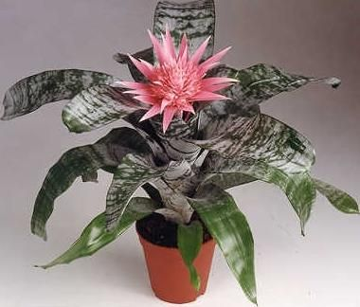
Aechmea fasciata cv./ Silver Vase Bromeliad
Stemless plant
Stiff, arching, broad, strap-shaped, silvery-green leaves
Plant 1-2’ tall
Leaf margins have black spines
White scales on leaves can be rubbed off

Slide 4
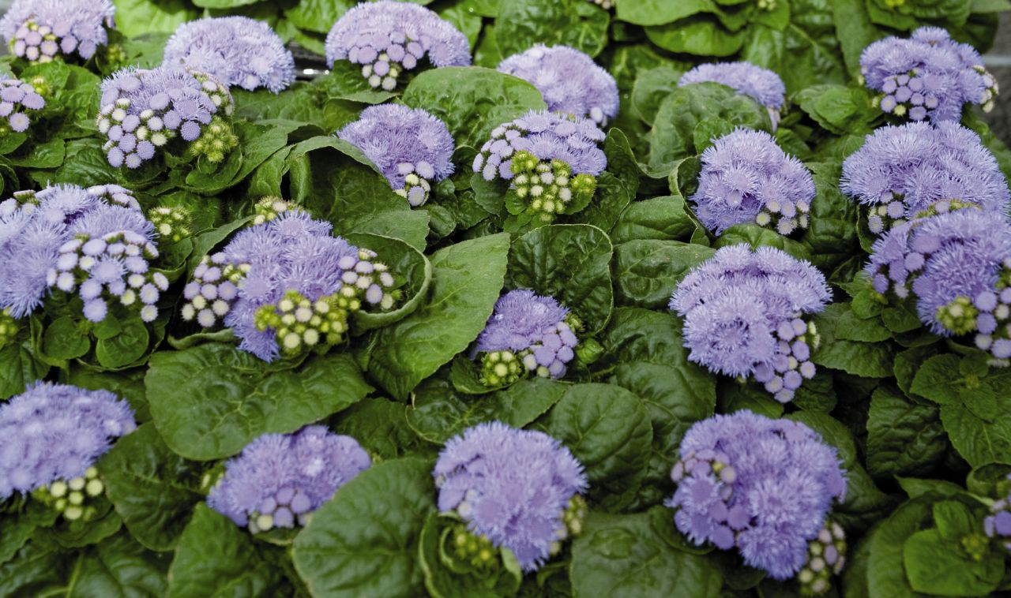
Ageratium houstonianum/Ageratum
Bedding plant
Fluffy flowers in flattened to slightly rounded clusters atop compact, mounded plants
4” to 18” tall
Leaves typically rounded, cordate-at-the-base, hairy, slightly quilted, soft green

Slide 5
Alstroemeria hybrid cv./ Peruvian Lily
Top slender, upright stems in bushy clumps 2-3' tall
Flowers yellow or orange often with spotting and streaking in terminal clusters of small, lily-like flowers
Narrow, twisted, lance-shaped leaves ~4" long, veins run parallel to margins

Slide 6
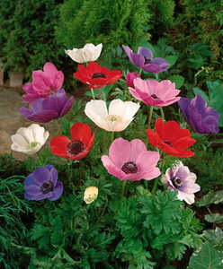
Anemone coronaria/ Anemone
Leaves medium green with basal leaves biternate and involucral leaves deeply divided.
Solitary, showy, poppy-like flowers (2.5” in diameter) with 6-8 sepals
Bloom in spring on stems 10-12” tall

Slide 7
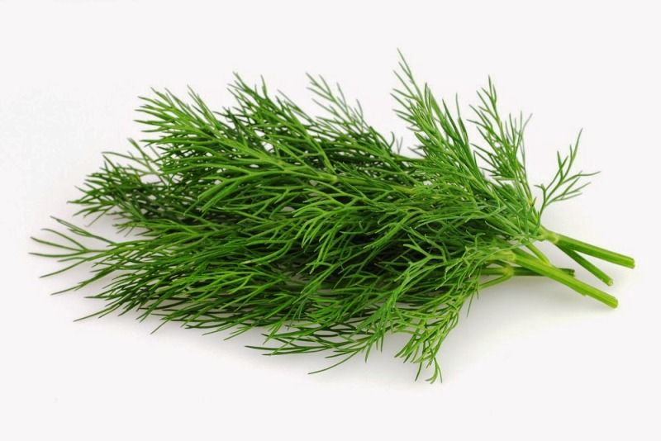
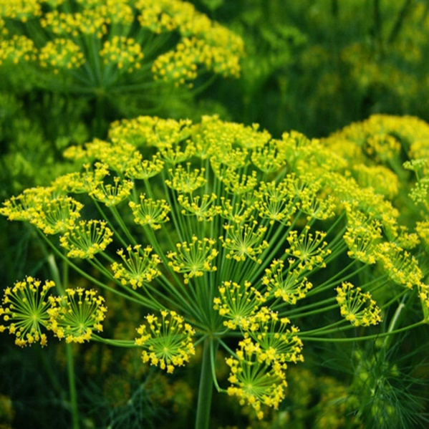
Anethum graveolens cv./ Dill
3-5' tall on stiff hollow stems
Aromatic, lacy, delicate, blue-green leaves pinnately divided into fine, thread-like segments
Taller plants may flop and need protection from strong winds
Scented, yellow flowers bloom in mid-summer in large, flattened, compound umbels (each to 10" diameter)
Flowers followed by aromatic seed

Slide 8
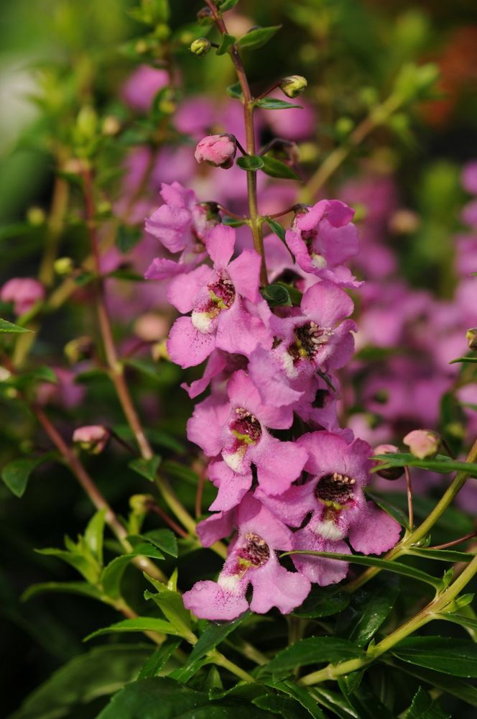
Angelonia hybrid cv./ Angelonia
12-18” tall
Oblong to lanceolate, green, slightly aromatic leaves (to 3” long) with toothed margins
Bluish-purple flowers (3/4” across) bloom late spring to early fall in narrow terminal spikes (8” long)
Two-lipped flowers similar to snapdragon
Cultivars available in white, blue, light pink and bicolor

Slide 9
Anthurium x andraeanum cv./ Flamingo Plant
About 16” tall
Long-lasting, waxy, palette-shaped, bright-red spathes (flowers) with a yellow spadix
Drooping, heart-shaped, dark green leaves arise on long stems from plant crown
Flowers may appear throughout the year in optimum growing conditions

Slide 10
Antirrhinum majus cv/ Snapdragon
Upright form
Flower well from spring to fall
Dragon-shaped, tubular, two-lipped, closed flowers
Flowers come in both pastel and bright colors such as shades of white, yellow, red, pink, orange, peach and purple (some bicolors)
Lance shaped, glossy dark green leaves (to 3” long)

Slide 11
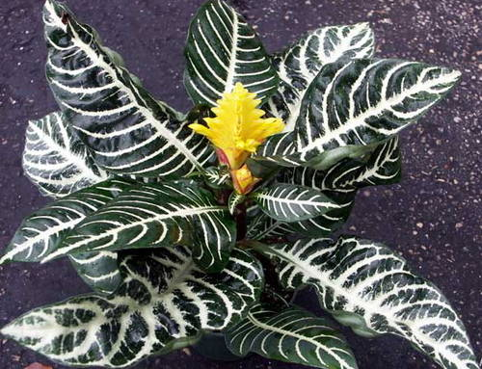
Aphelandra squarrosa cv./ Zebra Plant
Leaves are ovate to elliptic in shape
Dark green leaves with zebra-like white veins
Spikes of yellow-bracted flowers are long-lasting
Typically pruned to 12-18” tall.

Slide 12
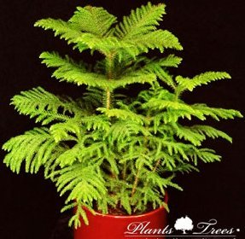
Araucaria heterophylla/ Norfolk Island Pine
Has needles on stems as well as branches
Needles are modified leaves
Tree form
Can get very tall (50-70 feet)

Slide 13
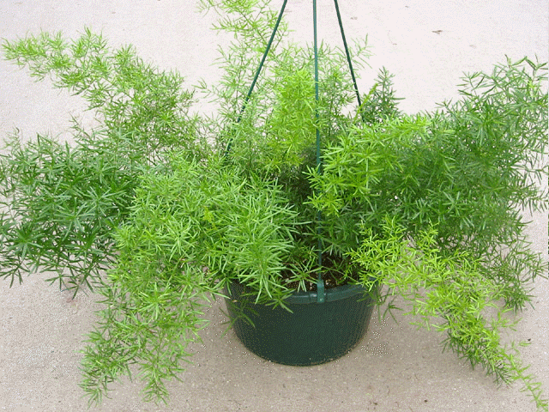
Asparagus densiflorus/ Sprengeri Fern
Dense foliage forms arching mound that matures 1-3’ tall and spreads 3-4’ wide
Leaflets create bushy tail
Plant has small thorns

Slide 14
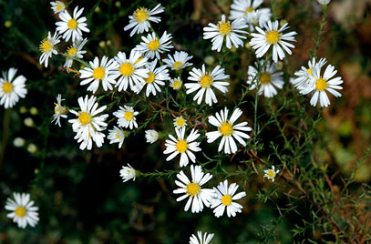
Aster pringlei/ Monte Cassino Aster
Compact, clump-forming aster that forms rounded foliage mound 24-30” tall and wide
Profuse daisy-like asters (1” diameter) with violet-blue rays and yellow center disks
Flowers late summer to early fall.
Narrow, oblanceolate to linear medium green leaves (4” long).

Slide 15
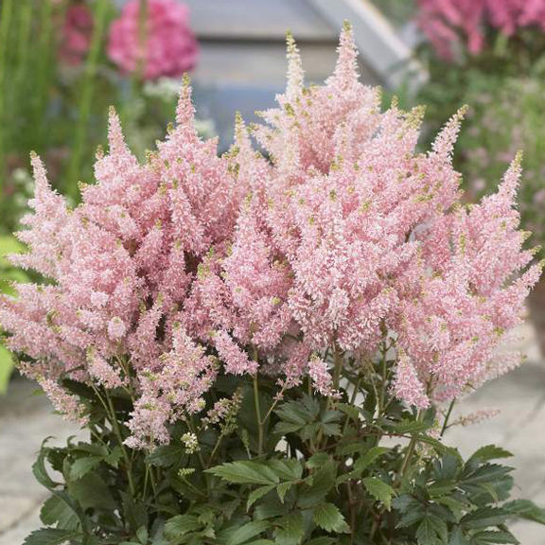
Astilbe hybrid cv./ Astilbe
Graceful, fern-like mounds of mostly basal, 2-3 ternately compound leaves with sharply-toothed leaflets
Tiny flowers densely packed into erect to arching, plume-like panicles rising above foliage on slender, upright stems

Slide 16
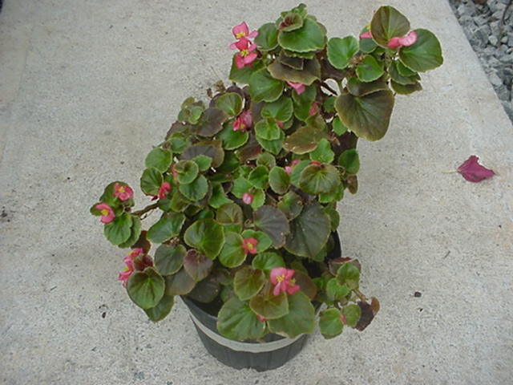
Begonia x semperflorens-cultorum/ Wax Begonia
Waxy leaves gives glossy look
Leaf margins look like torn paper, rough, ragged edges
Leaves can be green or bronze

Slide 17
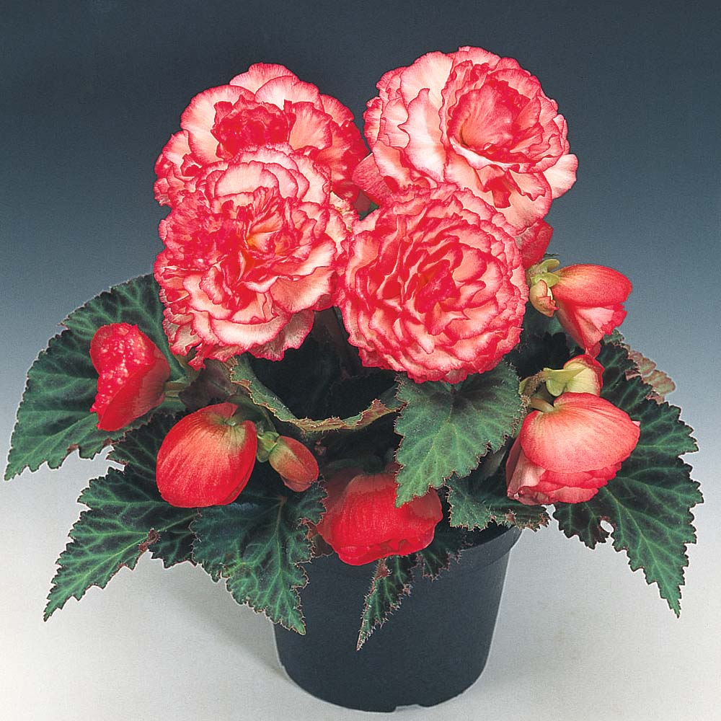
Begonia x tuberhybrida cv./ Tuberous Begonia
12-18" tall
Brightly colored waxy-petaled flowers
Colors ranging from white to yellow to apricot to pink to rose to red.
Leaves are simple and have wavy or serrated margins.

Slide 18
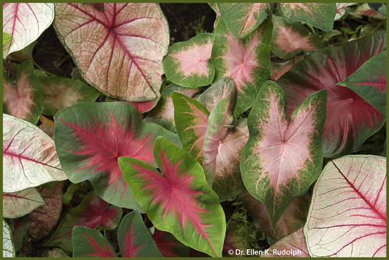
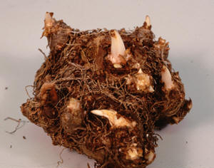
Caladium x hortulanum cv./ Caladium
Grows from a tuber
Plants grow in clumps 1-2.5' tall
One leaf per stem
Arrowhead-shaped leaves (~1.5' long) various shades of green mottled and blotched with pink, red, white or combinations thereof; distinctively colored veins
Calla-type flowers, if present, are usually hidden

Slide 19
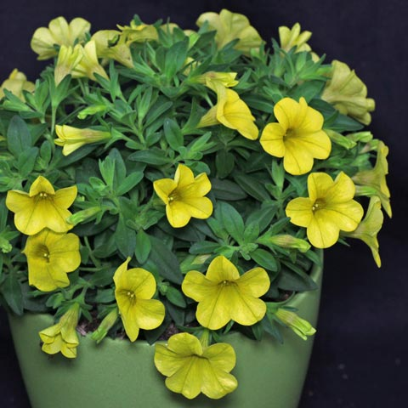
Calibrachoa hybrid cv./ Million Bells
Flowers look like small petunias
Compact, mounded plants grow 3-9” tall on mostly trailing stems.
Prolific bloomers produce hundreds of 1” wide flowers from spring to frost
Flower colors include shades of violet, blue, pink, red, magenta, yellow, bronze, and white

Slide 20
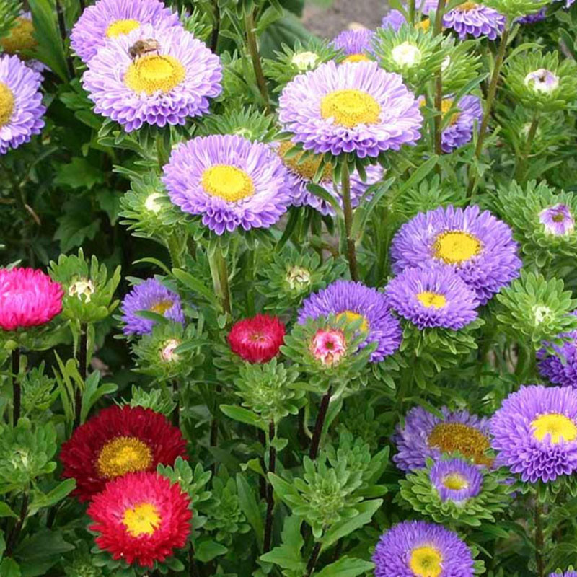
Callistephus chinensis cv./ China Aster
Ovate, toothed, medium green leaves.
Cultivar height ranges from 8-inch dwarfs to 36-inch tall plants
Flower varies by cultivar from single daisy-like heads with yellow centers to fully double flower heads with shaggy to pompom form
Colors include shades of white to pink, red, blue, violet, purple and yellow.

Slide 21
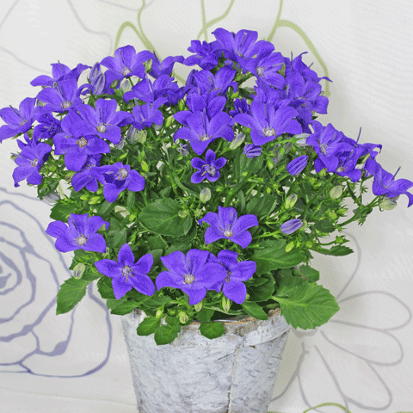
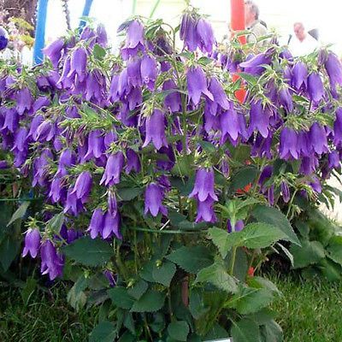
Campanula hybrid cv./ Campanula
Drooping, tubular, bell-like flowers (up to 2" long)
Flowers purple, pink, white
Erect to slightly arching stems

Slide 22
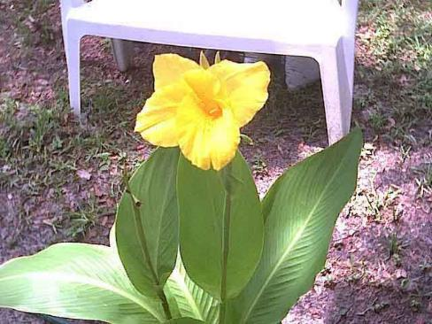
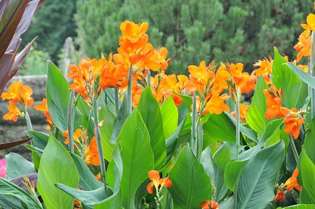
Canna x generalis cv./ Garden Canna
Leaves come in variety of colors from variegated to green or red
Can be 4-6’ tall
Large flowers resemble that of an iris
Flowers are orange, yellow or red

Slide 23
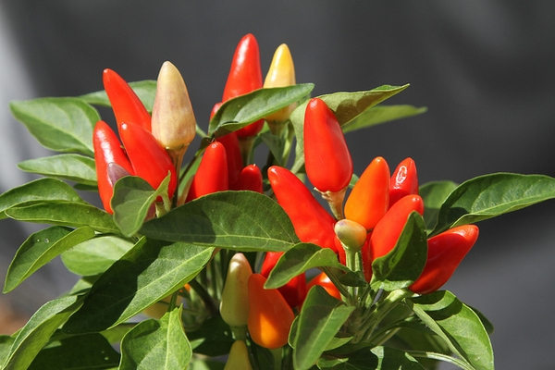
Capsicum annuum/ Ornamental Pepper Plant
Shrubby mounds 1-4’ tall
Lance-shaped to oval medium green leaves
Star to bell-shaped white or yellow flowers give way to edible peppers ranging from extremely hot chili peppers to sweet bell peppers
Many cultivars developed for ornamental use featuring attractive peppers in bright shades of red, yellow, purple, orange and brown.

Slide 24
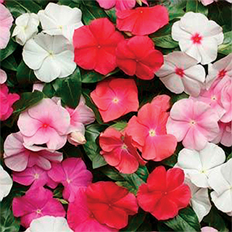
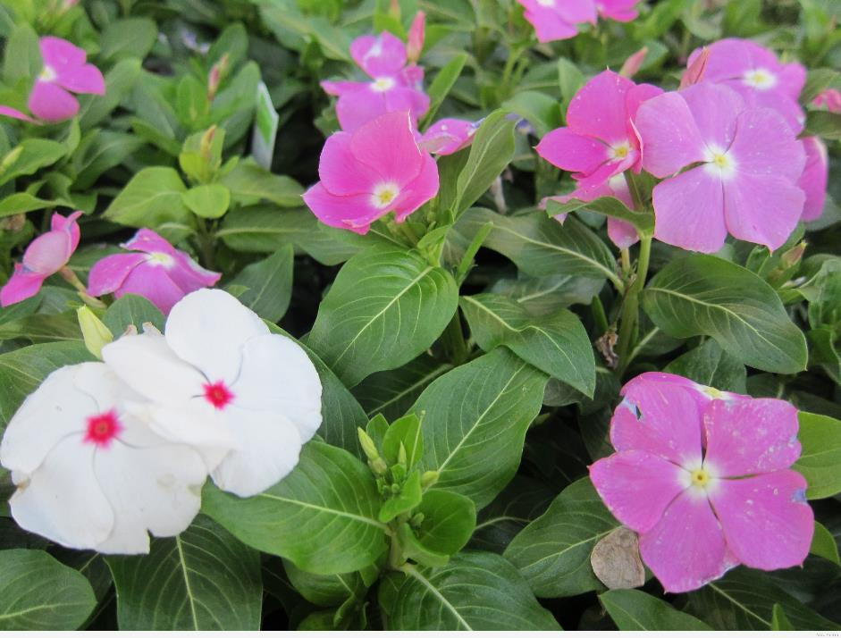
Catharanthus roseus/ Vinca
Flower bud has pinwheel shape
Mounding 6-18” (less frequently to 24”) tall and as wide
Flowers have five flattened petal-like lobes and appear in upper leaf axils
Colors include pale pink, rose, hot pink, red, lilac, and white, often with contrasting darker throats/eyes
Oblong to ovate glossy, green leaves (2” long) with white midrib

Slide 25
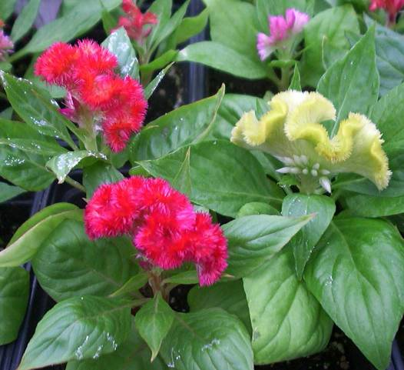
Celosia argentea cv./ Cockscomb
Midrib gets progressively lighter in color towards end of leaf
Fasciated, large crested flower heads (3-12” across), with each flower head somewhat resembling the comb of a rooster.
Flower colors include bright shades of orange, red, purple, yellow and pink.
Flowers bloom throughout summer into fall (sometimes to frost) on stems clad with spear-shaped green to red purple leaves.

Slide 26
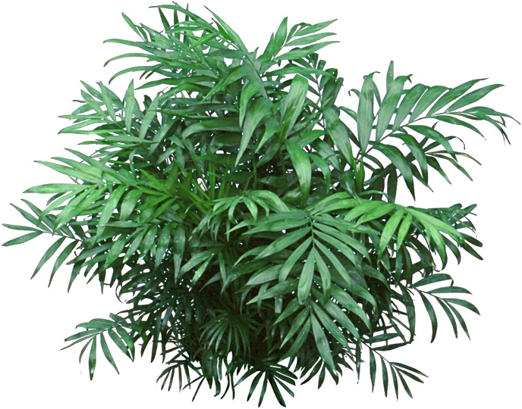
Chamaedorea elegans/ Parlor Palm
Small, compact, usually single-trunked palm
Usually grows to 4' tall
Dense, attractive foliage, compact shape and easy maintenance.
Handsome, arching, green pinnate leaves, with 12 or more pairs of narrow leaflets per leaf, lend a tropical flair to indoor locations.

Slide 27
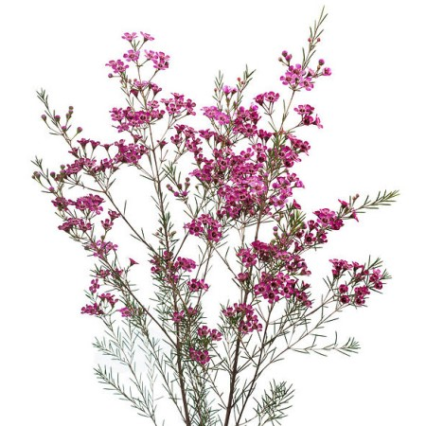
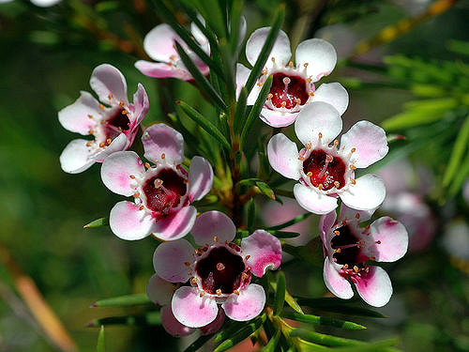
Chamelaucium uncinatum/ Waxflower
Small, woody shrub
Usually grows to 1.5 – 3’ tall
Erect growing habit
Pink, purple or white flowers
Flowers ½’ across, occur along stems with needle-like leaves.
“Uncinatum” means hooked at the point referring to the ends of the leaves.

Slide 28
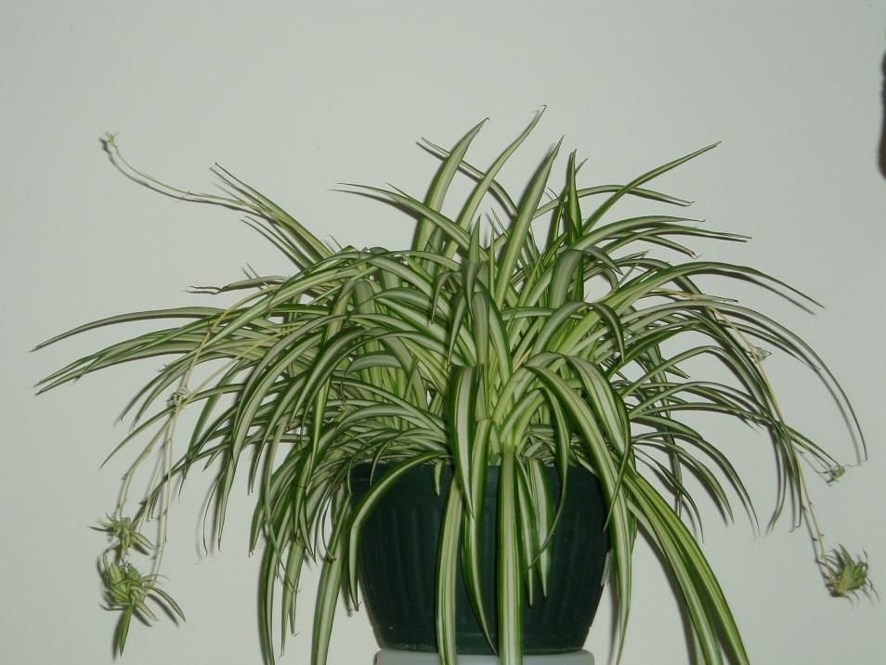
Cholorophytum comosum cv./ Spider Plant
It has linear leaves that are green or striped white.
Flowering stems bear loose panicles of small, white, starry flowers.
Plantlets are formed at the flowering nodes.
When plants are full, they have an interesting, graceful, cascading habit.

Slide 29
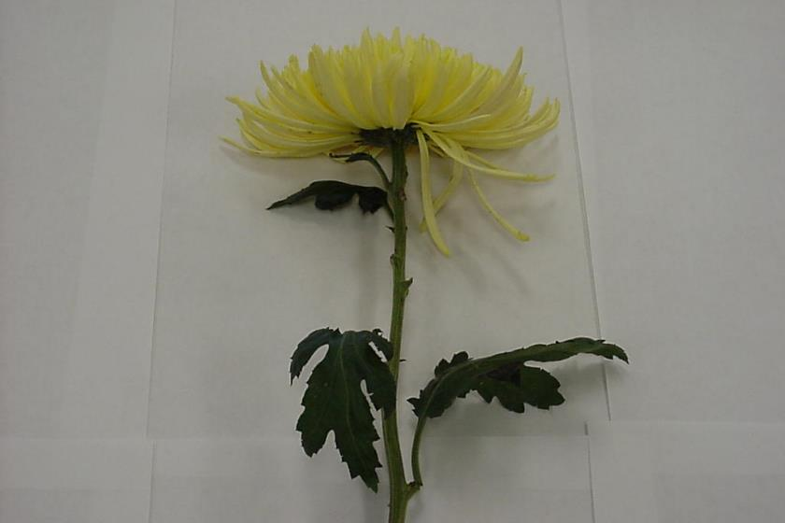
Chrysanthemum x morifolium / Florist’s Chrysanthemum
Flower comes in many different styles
Lobed, medium green leaves (to 2” long).
Leaves have 5 main lobes

Slide 30
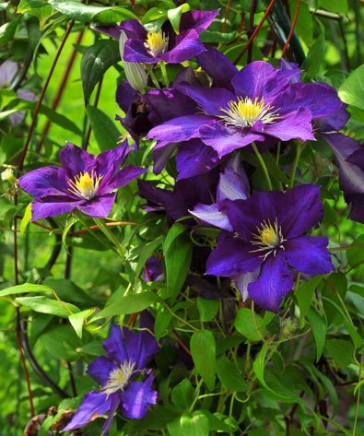
Clematis hybrid cv./ Clematis
Leaves are compound, leaves attach to trellis to help hold the plant upright – veins palmate
When petals fall off, usually leave pistil behind
Grows as a vine so usually on a trellis or stake
Very thin stem

Slide 31
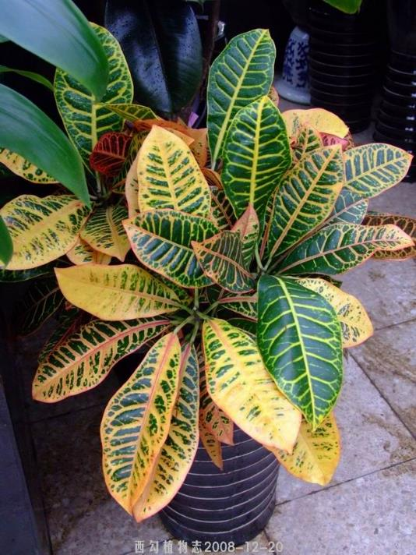
Codiaeum varigatum pictum/ Croton
Foliage is almost always multi-colored
Woody plant that is grown for its foliage
Can be cork screw or slender leaf, grown as a potted plant

Slide 32
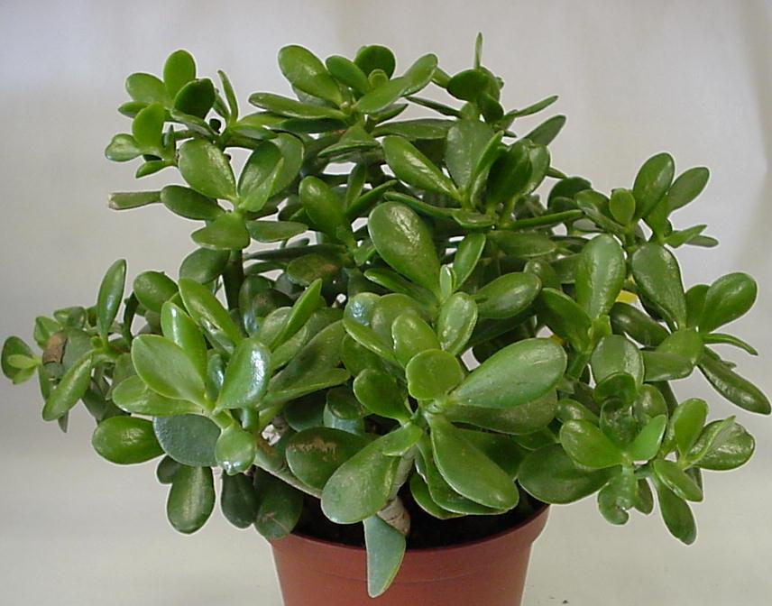
Crassula argentea / Jade Plant
Oblong, fleshy, shiny, evergreen leaves (to 2” long).
Leaves may acquire red tints when grown in direct sun.

Slide 33
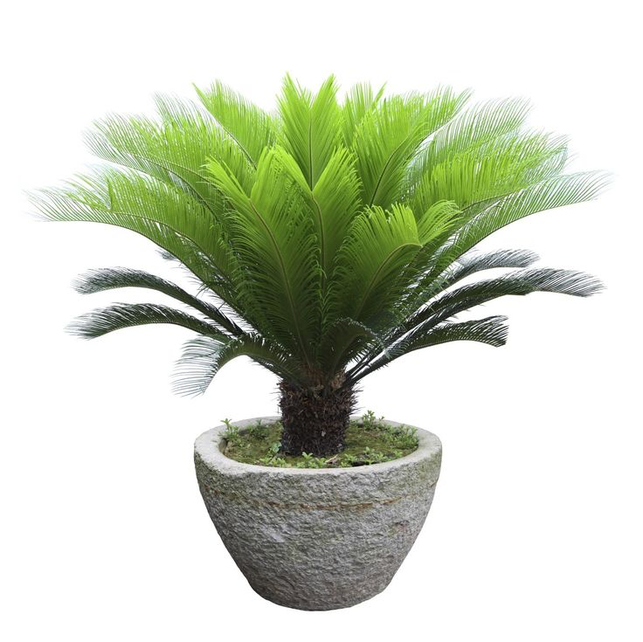
Cycas revoluta cv./ Sago Palm
Symmetrical plant
Trunk is thick and shaggy, typically about 7.9” in diameter
Trunk is very low to ground in young plants, but lengthens above ground with age.
Can grow over 20 feet of trunk in very old specimens.
Trunk can branch several times, producing multiple heads of leaves.
Leaves are shiny and dark green, and grow out into a feather-like rosette to 3.3 ft in diameter.

Slide 34
Cyclamen x persicum cv./ Florists’ Cyclamen
Margin has very fine teeth and a halo of light color
Flowers can be a variety of colors, flowers fold up
Very coarse leaf

Slide 35
Cymbidium cv./ Cymbidium Orchid
Leaves are long and skinny compared to other orchids
5 petals to the flower
In the throat has a rolled up “tongue” inside of throat
No stem except for flower spike
Backside has a sharp midrib
Has “bulbs” just above the ground

Slide 36
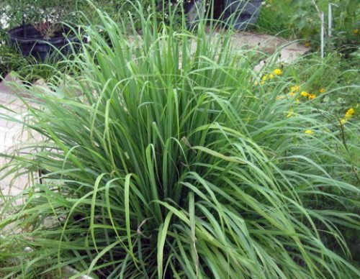
Cymbopogon cv./ Lemongrass (herb)
Tropical plant
Ornamental grass
Grows 2-4’ high
Leaves have lemon scent
Used for culinary and medicinal purposes

Slide 37
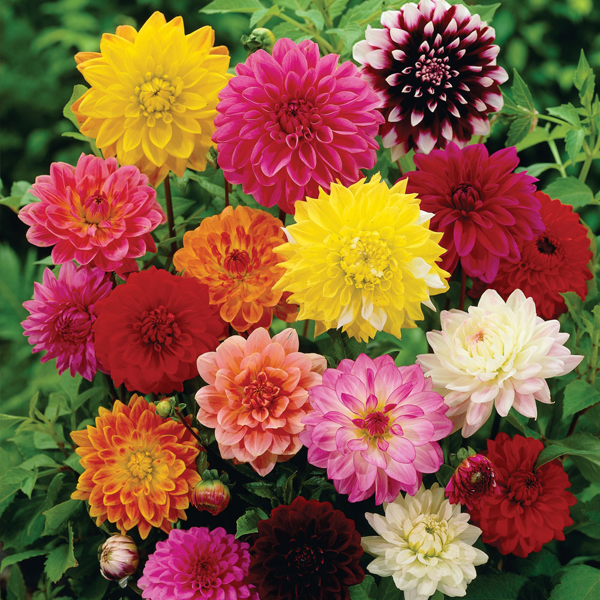
Dahlia hybrid cv./ Dahlia
Grows 1-6’ Tall
Bushy habit
In Asteraceae family (with daisies, sunflowers, chrysanthemums and zinnas)
Tuberous perennial
Leafy stems with one flower head per stem
Multi-layered flowers are unscented, bright and widely varied in color
Popular garden plant and cut flower

Slide 38
Delphinium consolida cv./ Larkspur
Perennial that grows 3-4’ Tall
Upright growth habit
Multiple flowers combine to create long, spear-like flower heads
Typically white, pink, lavender, blue or dark-blue flower color
Deeply lobed leaves with three to seven toothed, pointed lobes in a palmate (hand) shape.
Leaves can be very fine in texture, as shown in photo on left.

Slide 39
Dendrobium cv./ Dendrobium Orchid
Thick, very apparent stem
Smallest flower of all the orchids
Leaf is rubbery
Aerial roots (Above soil-line)

Slide 40
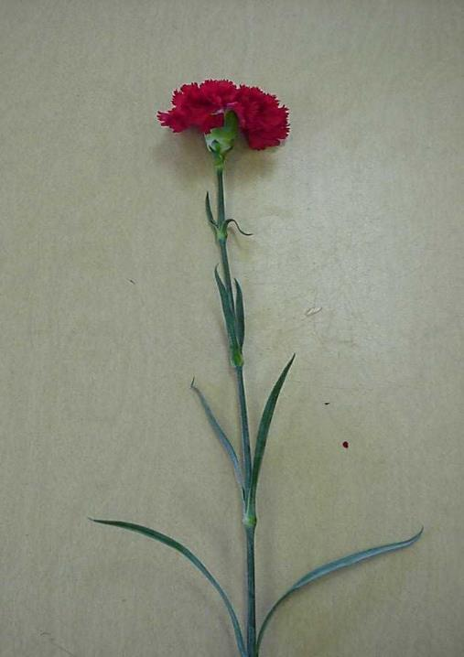
Dianthus caryophyllus cv./ Carnation
1 flower head per stem, ruffled edges of flower
Grayish appearance to leaves & stem
Very pronounced nodes and long internodes
Leaves opposite in twos

Slide 41
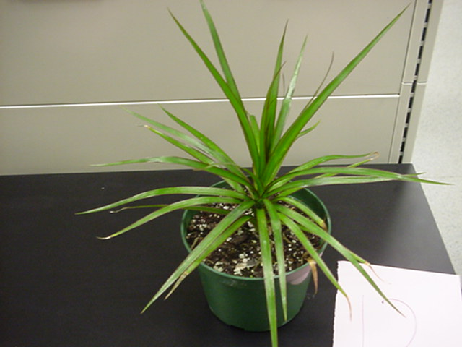
Dracaena cincta / Red Edge Dracaena
Grows on a stalk
Bottom of the stalk sometimes drops its lower leaves – leaving a bare cane appearance
Is a large upright plant
Edges of the plant are indeed red

Slide 42
Echinocactus cv./ Barrel Cactus
A cactus that can grow up to 2’ tall.
Almost perfectly round when young, but will sometimes stretch into an oval as it grows.
Has evenly spaced spines and deeply ribbed lobes.

Slide 43
Epipremnum aureum cv./ Golden Pothos
Leaves are always marbled either green & white or green & yellow
Trailing growth pattern
Stipule is a small piece of tissue that is fused to the stem, unlike philodendron, creates the appearance of a ribbed node

Slide 44
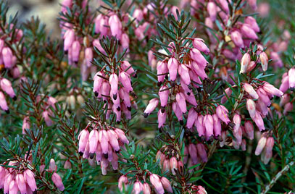
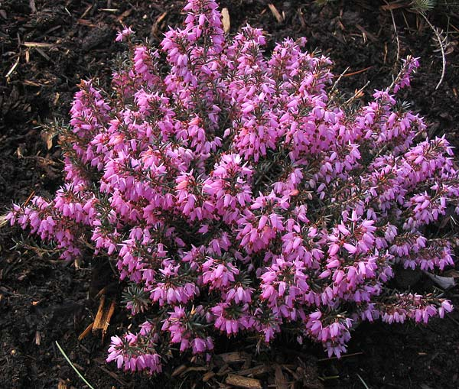
Erica carnea cv./ Spring Heather
Grows 6” to 12” tall.
Broadleaf evergreen with a mounding growth habit
Light to dark pink, narrow, bell shaped flowers, 0.16-0.24” long
0.16-0.31” needle-like leaves

Slide 45
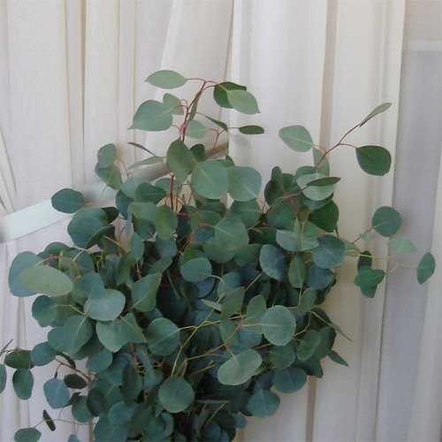
Eucalyptus polyanthemos / Silver Dollar Eucalyptus
Large evergreen tree with upright growth habit.
Matures to 30-75’.
Foliage is aromatic, silver/green and about the size of a one dollar coin.
Often used in floral arrangements for unique foliage.

Slide 46
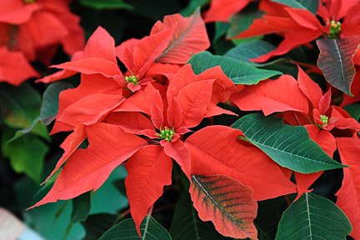
Euphorbia pulcherrima cv./ Poinsettia
Flowers are actually modified leaves known as bracts
Midrib on the leaves is usually white
They come in many colors but red is most common

Slide 47
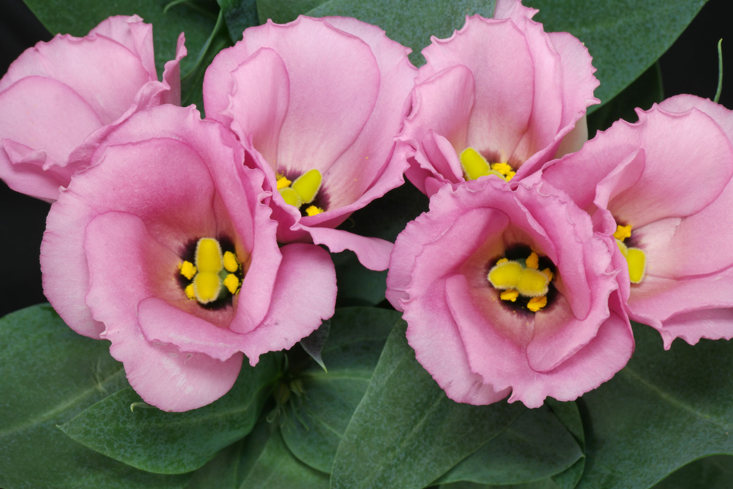
Eustoma grandiflorum/ Lisianthus
A biennial or annual
Grows on erect single to sometimes branching stems to 3’ tall.
Large bell-shaped flowers (to 2” across)
Flaring pale purple petal-like lobes bloom from the upper leaf axils.
Flower colors including various shades of pink, blue-violet and white.
Ovate to oblong, 3-5 veined, stem-clasping, gray-green leaves (to 3” long).

Slide 48
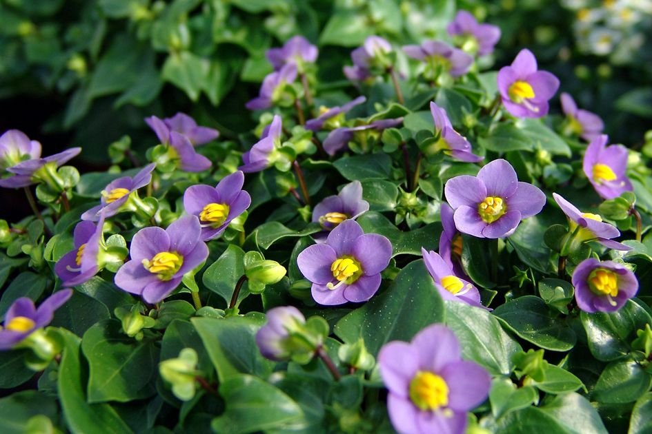
Exacum affine / Persian Violet
A 6-12” tall annual with shiny green foliage.
Tiny leaves of this rounded plant are oval in shape and densely cover the stems.
Flowers are blue with bright yellow pollen masses in their centers appear in the spring and summer.
The flowers are fragrant and will densely cover this plant if grown under the proper cultural conditions

Slide 49
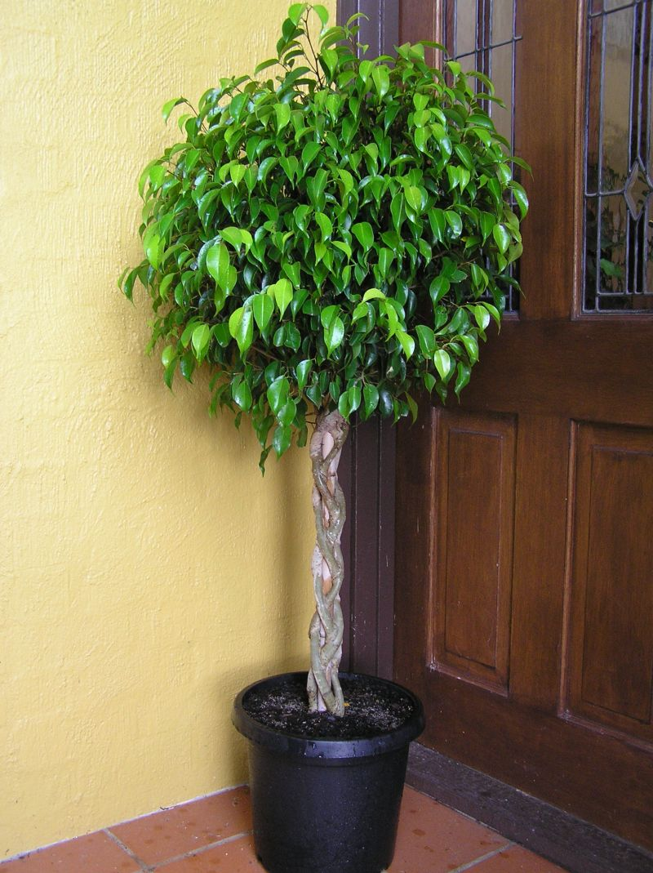
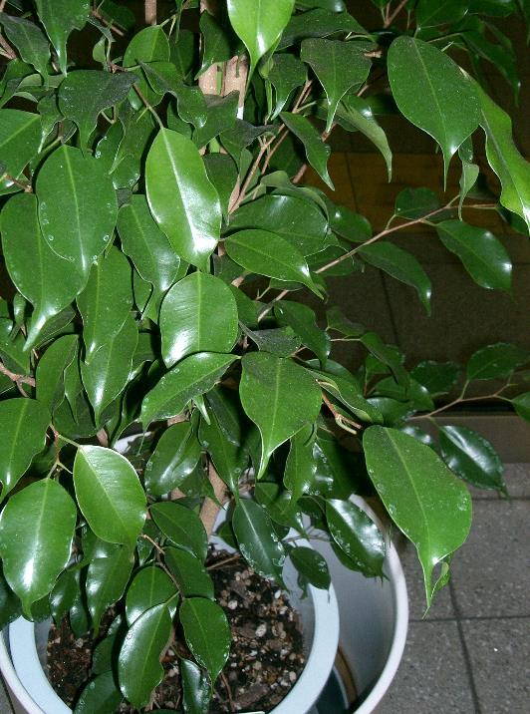
Ficus benjamina cv/ Benjamin Fig
Leaves can be solid green or variegated
This is a tree – can be 1 foot to 20 feet tall
Leaves have a “tail” on the end
Produces white milky sap
Woody Stem

Slide 50
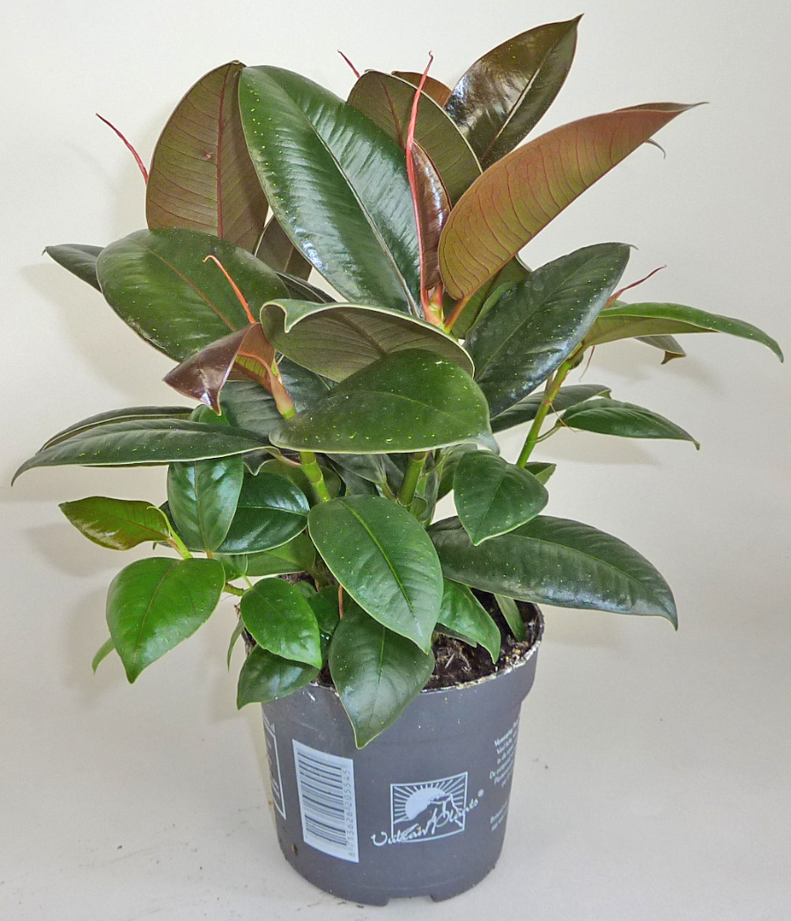
Ficus elastica cv/ Rubber Plant
New growth has reddish color
Midrib has reddish color
Leaf bud is very distinct
The bud also has a sheath that will fall off

Slide 51
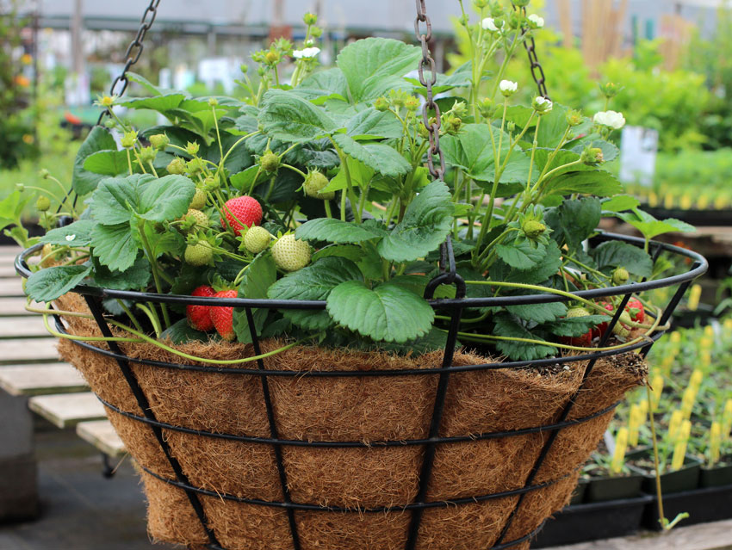
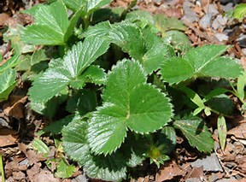
Fragaria x ananassa cv./ Strawberry Plant
Five-petaled white flowers with yellow centers
Flowers appear on the plants in early spring and give way to large red berries which mature in late spring to early summer.
Leaves are compound with three leaflets and have serrated edges

Slide 52
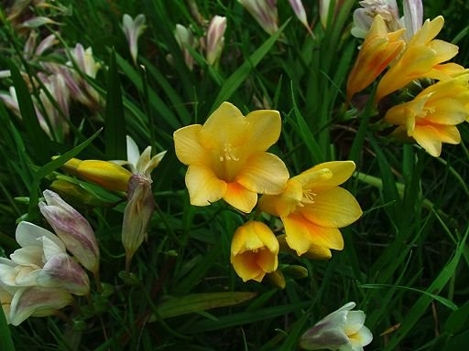
Freesia x hybrida / Freesia
Noted for fragrance and bright flower colors.
Frost tender perennial that grow from corms.
The large-flowered hybrids sold by florists feature sweetly fragrant, funnel-shaped flowers (5-10 per stem)
Flowers bloom in one-sided racemes atop leafless, arching, wiry stems to 18" tall.
Narrow, sword-shaped leaves appear in an iris-like fan.

Slide 53
Gardenia jasminoides / Gardenia
Veins sit down/ indented into the leaf
Leaves turn bright yellow before they fall off
Flower buds have sepals that stick up
Waxy leaves
Very fragrant

Slide 54
Gerbera jamesonii / Gerbera Daisy
Flowers come in a variety of colors
Stays low to the ground
No visible stem except flower “stem”

Slide 55
Gladiolus x hortulanus cv./ Garden Gladiolus
Flowers bloom stacked on top of each other, variety of colors
Flowers come out alternate on the stem
Midrib is raised on the leaf

Slide 56
Gomphrena hybrid cv./ Globe Amaranths
12-24” tall with an upright branching habit.
The true flowers are insignificant, tiny, white to yellow trumpets that are only visible close up.
The bright magenta bracts arranged in a globe shape have a papery-texture and clover-like flowerheads.
Flowerhead colors include red, pink, purple, lilac, violet and white.
Narrow oblong to elliptic green leaves (to 4” long).

Slide 57
Gypsophila elegans cv./ Baby’s Breath
Large clusters of white flowers, have a unpleasant odor
Usually no foliage
Stems come out at 45° angle

Slide 58
Hedera helix cv./ English Ivy
Ground cover
Vining, Trailing Growth Pattern
Leaves have 3 main lobes
Comes in solid green and different variegated patterns

Slide 59
Helianthus annuus / Sunflower
Typically grows 5-10’ tall on stiff upright stalks.
Coarse, hairy, leafy, fast-growing annual
Species plants feature 3-6” wide sunflowers with orange-yellow rays and brown to purple center disks.
Flowers in bright and pastel shades of yellow, red, mahogany, bronze, white and bicolors
Flower head shapes vary (short rays/petals, long rays, some doubles).
Dwarf varieties (1-3’ tall) and mammoth varieties (to 15’ tall) are also available.
Flower heads on mammoth varieties can reach 12” in diameter.
Large, ovate to triangular, sandpapery leaves

Slide 60
Hemerocallis cv./ Daylily
Flowers are typically funnel-shaped to bell-shaped.
Each flower has six segments.
Flowers range in size from 3-8” across and ruffled edges.
Flowers bloom on naked modified stems from spring to late summer.
Each plant features grass-like to sword-shaped foliage.
May grow from 1-6’ tall, but most mature to about 3-4’.
Usually a perennial, but sometimes semi-evergreen or evergreen.

Slide 61
Hippeastrum hybrid cv./ Amaryllis
Bulb, if planted correctly the bulb should show
Leaves opposite, USUALLY same # on each side
Does not have a pronounced mid-rib more of a swollen area on the back of the stem
Large flowers, multiple flowers come out of same point

Slide 62
Hosta cv./ Hosta
Herbaceous perennial that forms a clump.
Primarily grown for their ornamental foliage.
Variety of leaf shapes, sizes, colors and textures form a rounded to spreading mound of foliage.
Bell or funnel-shaped flowers.
Blooms in late spring or summer on vertical, unbranched, usually leafless stems.
Stems with flowers rise upward from the crown or rootstock often well above the foliage mound.

Slide 63
Hoya carnosa / Wax Plant
Climbing or trailing perennial of the dogbane and milkweed family.
Grows 2-4’ indoors.
Trailing stems will climb counterclockwise around wire or other thin trellis-like structures.
Plants feature glossy, elliptic, fleshy, dark green leaves (to 4” long)
Tight rounded clusters (umbels) of fragrant white summer flowers.
Each tiny flower (to 1/2” diameter) sports a distinctive, star-shaped, red-centered corona.
Each cluster may include from 10-30 flowers.

Slide 64
Hyacinthus orientalis cv./ Hyacinth
Flowers come in a variety of colors
Leaf folds up into a boat shape
Bloom very early in the spring,
Very fragrant flowers
Bulb has purplish tint with very flat bottom

Slide 65
Hydrangea macrophylla / Big Leaf Hydrangea
Large clusters of sepals makes large flower heads
Serrated edges on the leaf
Leaf veins very noticeable and opposite

Slide 66
Impatiens hybrid cv./ Impatiens
At the end of every vein is a small soft thorn
Stem is translucent – can see through the stem
It looks like the flower has two stems, but only one attaches to the plant. The other is a nectary gland, and pests like thrips can be found inside of it, lapping up nectar

Slide 67
Ipomoea batatas cv./ Ornamental Sweet Potato
Tender perennial
Popular root vegetable
purple, chartreuse and variegated-leaved cultivars
A popular ornamental foliage plant.
Stems typically mound to 9” tall but spread by trailing stems to 8-10’ wide
Leaves of the ornamental varieties are heart-shaped to palmately lobed (to 6” long)
Ornamental varieties usually do not flower.

Slide 68
Iris x xiphium cv./ Dutch Iris
Smaller flowers compared to regular irises
Bearded can be purple/ blue or yellow and white
Leaves are very slim and silvery on the inside

Slide 69
Senecio cineraria / Dusty Miller
Leaves silver or gray in color
Lobed Leaf
Leaves are fuzzy and soft to the touch

Slide 70
Justica brandegeana / Shrimp Plant
Very long internode between leaves
Flower is pink with yellow markings
Shrub that has an open airy look – not compact
Leaves are opposite

Slide 71
Kalanchoe x blossfeldiana cv./ Kalanchoe
Has a spike of flowers that come in a variety of colors
Leaf is waxy, scalloped on the edges

Slide 72
Leucanthemum x superbum / Shasta Daisy
Grows 2-3’ tall in upright clumps
Flower is always white with yellow center
Has a long leaf with teeth on the margins that point in a upward motion

Slide 73
Leucospermum hybrid cv./ Pin Cushion Protea
Evergreen shrub grows to 19-40” tall.
Leaves are spirally arranged, tough and leathery.
Leaves are simple, linear to lanceolate, 0.8-4.7” long and 0.2-1.2” wide
Leaves have a serrated margin or serrated at the leaf base only.
The flowers are produced in dense inflorescences

Slide 74
Liatris spicata / Liatris
Grows one flower per stem
Flowers are usually purple
Foliage is very dense, grass-like leaves

Slide 75
Lilium hybrid cv./ Asiatic or Oriental Lily
Blooms come in many different colors
The “stem” that attaches each flower to the plant is longer than on an Easter lily

Slide 76
Limonium sinuatum / Statice
Purple is most common but also come in blue, white, and yellow
Stem and flower are very paper like
Stem also has a winged edge

Slide 77
Lobularia maritima / Alyssum
Very small delicate flowers – flowers can be shades of white, pink, or purple
Grows in a mounded shape
Leaves are roughly 1 inch long and only ¼ inch wide
Smells very sweet

Slide 78
Maranta leuconeura / Prayer Plant
Coloring in between the veins of leaves is always a reddish tint
New leaf is rolled as it starts to emerge
Shape of the leaf is very wide and leaf turns up at the margins

Slide 79
Matthiola incana cv./ Stock
Flowers come in different colors, blooms in clusters
Fuzzy leaf, leaves are very long and slender
Very fragrant

Slide 80
Monstera deliciosa / Split Leaf Philodendron
Leaves are solid green
Deep “cuts” start almost at the midrib and move to edge of the leaf
Actually grows out as a vine

Slide 81
Narcissus hybrid cv./ Daffodil or Narcissus
Flower resembles “tea cup & saucer”
Are usually yellow, white, or a mixer of the 2 colors
Leaf is flat with a very round end
Bulb is tear dropped shape

Slide 82
Nephrolepis exaltata cv./ Boston Fern
Typically in a hanging basket
Fern leaves are known as fronds
The fronds are solid green in color
Fronds droop over to cover the pot

Slide 83
Ocimum basilicum cv./ Basil
Grown as an annual
Grows between 12–51” tall
Leaves are opposite one another, light green, and silky
Leaves are 1.2–4.3” long and 0.39–2.36” wide.
The flowers are small, white in color and arranged in a spike.
Fragrant herb used in cooking.

Slide 84
Opuntia cv./Prickly Pear Cactus
Flat/ pad surface
Has thorns
The pads connect directly on top of each other

Slide 85
Paeonia cv./ Peony
Herbaceous perennial
Grows 1.5-3’
Leaves are compound, large and deeply lobed
Flowers vary in colors ranging from purple red to white or yellow

Slide 86
Paphiopedilum hybrid cv./ Lady’s Slipper Orchid
Characterized by the slipper-shaped pouches of the flowers
Not an epiphyte, so planted in root medium
The pouch traps insects so they are forced to climb up into the flower to collect or deposit pollen, thus fertilizing the flower

Slide 87
Pelargonium x hortorum cv./ Zonal Geranium
Un-opened flower buds face down
Flower “stem” is very long and raises above foliage
Fragrant flowers bloom in clusters
Leaves are round-oval with ruffled edges

Slide 88
Pelargonium peltatum cv./ Ivy Geranium
Very stout, wavy lobes on the leaf
Not as hairy as regular geranium

Slide 89
Pentas hybrid cv./ Pentas
A tropical woody-based perennial that grows to 1-2’ tall in beds or containers.
A many-branched, somewhat sprawling plant
Features 4” wide rounded clusters of star-shaped flowers.
Elliptic to lanceolate dark green leaves (to 6” long).
Flowers are pink, magenta, lilac or less commonly white.

Slide 90
Petroselinum crispum cv./ Parsley
Biennial, grown as an annual.
Grows in a clump to 12" tall
and as wide.
Triangular dark green leaves are finely divided into curly or flat leaflets.
Plants will bloom in the 2nd year by sending up stalks to 2-3' tall bearing compound round shaped clusters of greenish-yellow flowers.

Slide 91
Petunia x hybrida cv./ Petunia
Trumpet/ tube shaped flower – lots of colors
All the petals are attached together
Leaf is pointed and fuzzy, stem is fuzzy
Plant typically grows in a downward pattern

Slide 92
Phalaenopsis cv./ Moth Orchid
Leaves attach to a main stem and stay low the bottom of the stem
Very hard leathery leaf
Flower – has two distinct “wings”

Slide 93
Philodendron scandens oxycardium / Heartleaf Philodendron
Leaves heart shaped
Can be variegated or solid green leaves
Stem is very smooth, very round
Stipule is a small piece of tissue that is NOT fused to the stem, unlike pothos

Slide 94
Pilea cadierei / Aluminum Plant
Leaves arranged opposite one another
This is an upright, herbaceous perennial that is noted for its textured green and silver foliage.
Typically grows in a shrubby clump to 12” tall.
Elliptic to obovate, toothed, dark green leaves (to 3” long)/
Two silver stripes on leaves

Slide 95
Portulaca oleracea cv./ Portulaca
Features 2” diameter flowers in orange, yellow, red, pink, white and bicolors.
Plants typically grow 4-8” tall and spread to 15” wide.
Flowers bloom summer to frost.
Spatulate to ovate, flat, fleshy leaves (to 1.25” long).

Slide 96
Primula malacoides cv./ Primrose
Grows low to the ground
Raggedy edge on the leaf
Flowers in clusters
Center of the flower is always yellow
Veins are very distinct

Slide 97
Ranunculus hybrid cv./ Ranunculus
Herbaceous perennial
Finely-cut, parsley-like leaves
Grows in a mound to 12” tall
Some cultivars have peony-like flowers.

Slide 98
Rhododendron simsii cv./ Florist Azalea
Medium to large evergreen shrub
Leaves oval in shape and have small hairs on the top
Woody stem

Slide 99
Rosa hybrid cv./ Hybrid Tea Rose
One flower per stem
Petioles have a reddish tint
Has thorns

Slide 100
Rumohra adiantiformis / Leatherleaf Fern
Multi compound leaves
Has a hairy stem that is very long
Will sometimes have small, brown spores, which look like seeds, on the back of the leaf

Slide 101
Saintpaulia ionantha cv./ African Violet
Simple 5 petal flowers, one per ‘stem’ in large cluster
Small indentations on the leaves
Fuzzy leaf & petiole

Slide 102
Salvia splendens cv./ Salvia
Comes in a variety of colors, flowers is upright on a stalk with lots of blooms on one stem
Has a square stem
Leaf is triangle in shape

Slide 103
Sansevieria trifasciata cv./ Snake Plant
Plants will have a pattern on leaf similar to snake skin
Upright spiked leaf form

Slide 104
Schefflera arboricola / Dwarf Schefflera
Leaves can be variegated or solid green
palmately compound leaf
Green, thick stem

Slide 105
Schlumbergera bridgesii / Christmas Cactus
“Leaves” are actually a modified, flattened stem
Leaves attach one on top of the other

Slide 106
Sempervivum hybrid cv./ Hens and Chicks
Called hens and chicks because “babies” come out under mother plant
Thick stem, waxy leaves
Soft point at end of each leaf
in the succulent family

Slide 107
Senecio x hybridus cv./ Cineraria

Slide 108
Sinningia speciosa Fyfiana Group cv./ Florists’ Gloxinia
Flowers are trumpet shape
Very large leaves
Leaves are slightly hairy similar to African violet leaves

Slide 109
Solidago hybrid cv./ Solidago

Slide 110
Solenostemon scutellarioides / Coleus
Leaves come in multiple sizes, shapes, and colors
Square stem
Leaves are opposite

Slide 111
Spathiphyllum / Peace Lily
Leaves can be solid green or variegated
Flower is always white
long pointed leaf
Veins are cut into the plant

Slide 112
Stephanotis floribunda / Stephanotis
Grows to 20’ or more
An evergreen woody climber
Glossy, leathery oval leaves
Clusters of pure white, waxy, intensely fragrant tubular flowers

Slide 113
Strelitzia reginae/ Bird of Paradise
Has a bold structure, which forms large evergreen clumps of stiff leaves growing up from the base.
The grey-green banana-like leaves grow about 3 ½ to 4 feet in height and the flowers stand above the foliage at the tips of long stalks.
Structure of flower gives it the appearance of a bird’s head.
The flowers consist of 3 orange sepals and 3 bright blue petals.

Slide 114
Syngonium podophyllum / Nephthytis
Veins are different coloration from leaf – usually white
Arowhead shaped leaf

Slide 115
Tagetes species cv./ Marigold
Has a very distinct odor to ward off pests
Leaves are compound
Flowers grow in a pom/pom shape
Flower colors are typically shades of red, yellow, and orange

Slide 116
Tradescantia zebrina / Wandering Jew
Always purple in color, comes in darker shades of purple and purple/green combo
End leaf points straight out

Slide 117
Tulipa cv./ Tulip
Leaves have gray coating that rubs off
At end of life, flower opens all the way up
Leaf wraps around the stem
Small, round bulb with a papery “skin” called a tunic

Slide 118
Verbena hybrid cv./ Verbena
Stems and leaves are slightly hairy
Flowers in small clusters and in a variety of colors
Leaves are triangle shape

Slide 119
Viola x wittrockiana cv./ Pansy
Flowers have two layers of petals
Leaves have scalloped edges

Slide 120
Zantedeschia hybrid cv./ Calla Lily
Bulb
Flowers and leaves rise directly from rhizomes.
Typically grow in clumps to 24-36” tall
Feature large arrowhead-shaped (sagittate) leaves
Extremely showy flowers Commercially grown as a very popular cut flower.

Slide 121
Zinnia cv./ Zinnia
Annual
Composite, brightly colored flowers
No petiole – leaves go right up to stem
Growth pattern is upright
3 midribs to each leaf

