Slide 2
Lesson 9.4
Animal Feeds and Feeding

Slide 3
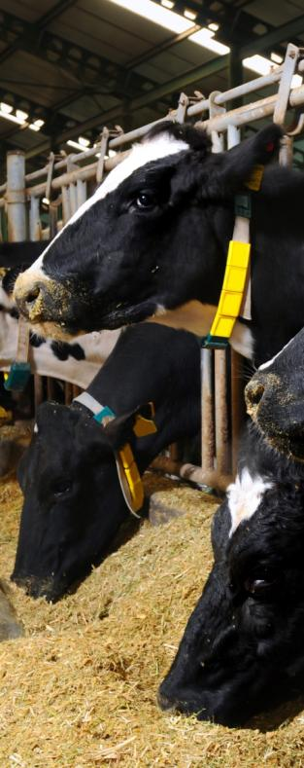
Lesson Outcomes
Identify the six major nutrients and explain their role in animal feeding
Determine the components of an animal ration
Explain the importance of feeding high-quality feeds
Official/Shutterstock.com

Slide 4
Lesson Outcomes
Compare and contrast the functions of different animal digestive systems
Examine some common digestive disorders
Official/Shutterstock.com

Slide 5
Nutrients
A nutrient is a substance that provides nourishment essential for growth and the maintenance of life
What are the six major nutrients an animal needs to survive?
Notes:
The six major nutrients animals need to survive are water, carbohydrates, fats, proteins, vitamins, and minerals (listed on following slide).

Slide 6
Nutrients
Six major nutrients animals need to survive
Water
Carbohydrates
Fats
Proteins
Vitamins
Minerals

Slide 7
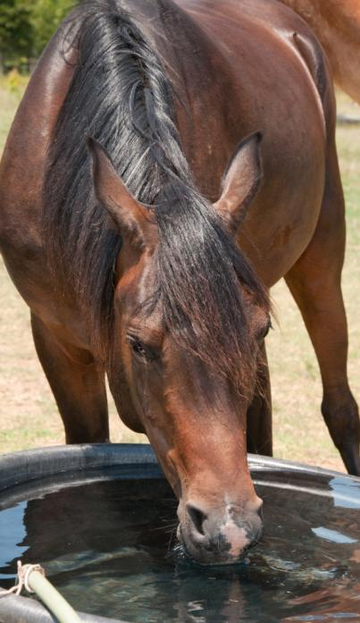
Water
Water is the single most important nutrient for any animal
Providing clean, free flowing, or regularly changed water for your animals is essential
Sari ONeal/Shutterstock.com
Notes:
Discuss the percentages of animal bodies that are made up of water (refer to text Figure 9-30).

Slide 8
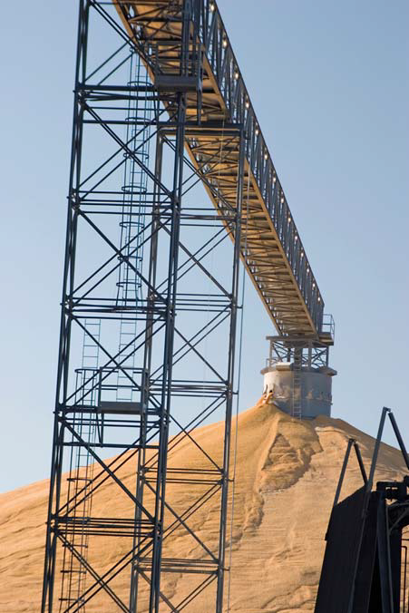
Carbohydrates
Carbohydrates provide energy
Carbohydrates are easily broken down for use
Unused carbohydrates are stored as fat
©iStock.com/wlfella

Slide 9
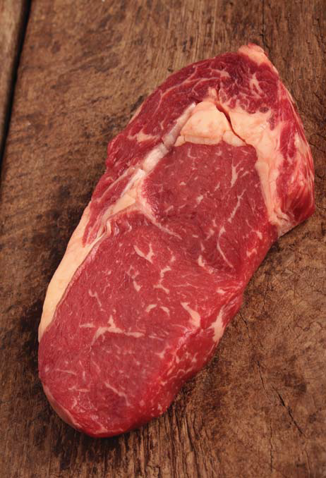
Fats
Fats provide long-term storage of energy
Production animals need adequate fat to produce high-quality meat
Fats are also called lipids
©iStock.com/neiljlangan

Slide 10
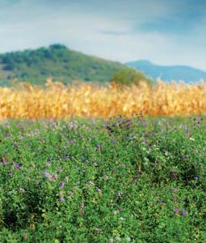
Protein
Protein is responsible for building and repairing cells
Protein is used to build muscle and all other structures
©iStock.com/cta88
Notes:
Image: alfalfa in field.
Discuss sources of protein in animal feeds.

Slide 11
Vitamins
Vitamins are organic compounds that are essential to life
Vitamins are classified as either
Fat-soluble
Water-soluble
Vitamins are stored in various parts of the body

Slide 12
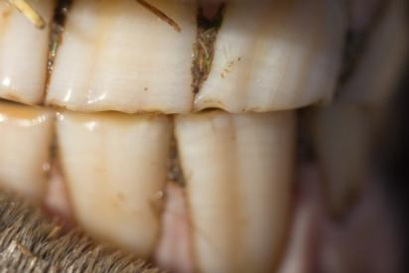
Minerals
Minerals are inorganic compounds required to sustain life
Unlike vitamins, minerals contain carbon
Minerals are used to form bones and teeth and carry oxygen throughout the body
schankz/Shutterstock.com

Slide 13
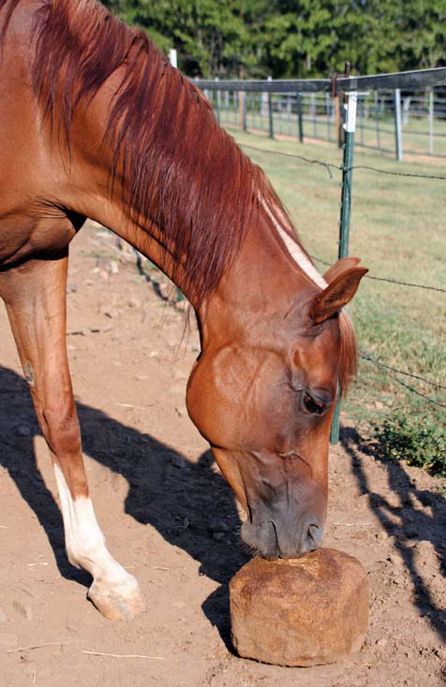
Minerals
Macrominerals include
Calcium
Phosphorous
Potassium
Sodium
Sulfur
Chloride
Magnesium
©iStock.com/sfmorris

Slide 14
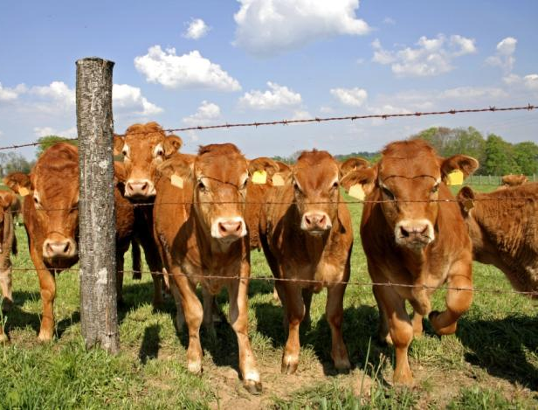
Nutrient Requirements
The amount of nutrients required are based on
Age
Species
Intended use
Individual genetics
paul prescott/Shutterstock.com

Slide 15
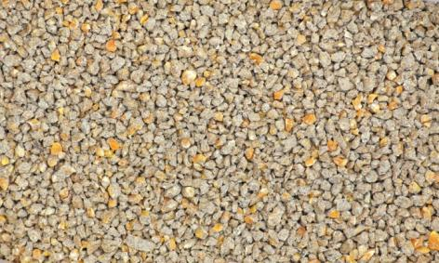
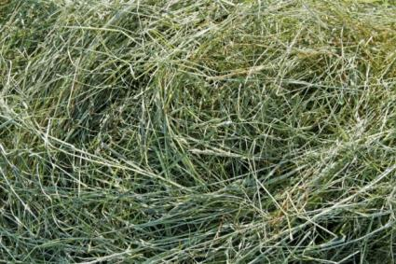
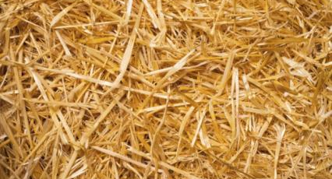
Types of Feed
There are two broad classifications of animal feed
Concentrates
Roughages
GOLFX/Shutterstock.com; Ratikova/Shutterstock.com; Guillermo del Olmo/Shutterstock.com
Notes:
Images: concentrate, grass hay, straw.
Ask students to identify other roughages fed to livestock (i.e., legume hays, rice grain, beet pulp, silage, fresh grass).

Slide 16
Concentrates
Feeds with high energy and TDNs
Typically low in fiber
Animals typically fed high-concentrate feeds include
Dairy cattle
Beef cattle
Swine
Layers
Broilers
Performance horses

Slide 17
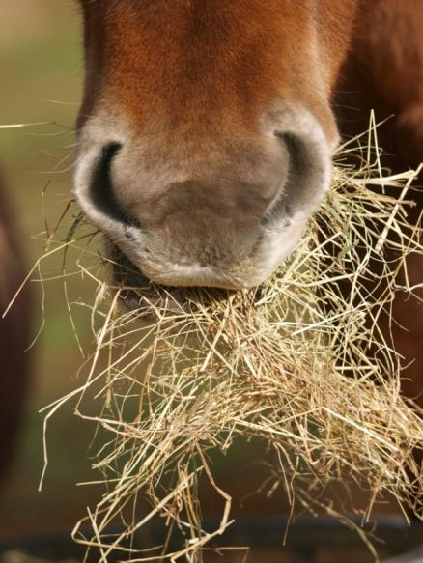
Roughages
Feeds with low energy and TDNs but high in fiber
Animals typically fed high roughage feeds include
Cows in cow-calf operations
Horses being fed for maintenance
Sheep used for wool production
eastern light photography/Shutterstock.om

Slide 18
Total Digestible Nutrients
Total digestible nutrients (TDNs) are the sum of the digestible fiber, protein, lipids, and carbohydrates in a feed
Feed categories are based on
Fiber
Energy
Total digestive nutrients

Slide 19
Feeding Considerations
The amount of feed consumed daily is called a ration
Important to understand the components of a balanced ration as well factors such as
Animal preferences
Feed quality
Feed costs

Slide 20
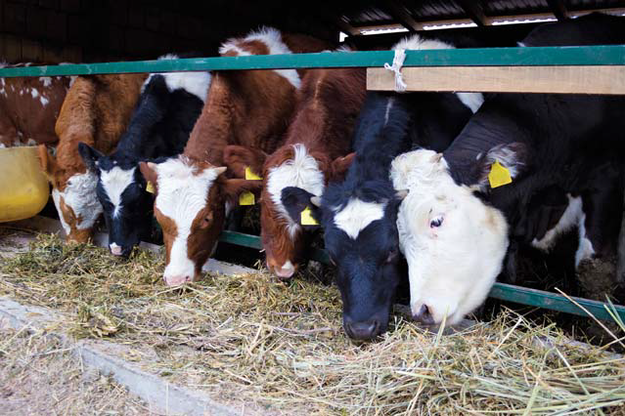
Animal Preference
How desirable an animal finds foodstuff is palatability
Higher palatability does not mean the feed is more nutritious
Appetite is how much an animal desires food of any type
©iStock.com/RGtimeline

Slide 21
Feed Quality
Different types of feed require different considerations as part of a ration
Key components in feed quality include
Harvested earlier or later than its peak time
Form of feed (whole versus processed)
How does the form of the feed impact its nutritional content?
Notes:
Ask students how the form of the feed impacts the nutritional content. For example, whole corn has a lower nutritional content than cracked, rolled, or steam-flake corn because the processed corn has already been partially mechanically broken down, making the digestion process easier for the digestive system of the animals.

Slide 22
Feedstuffs

Slide 23
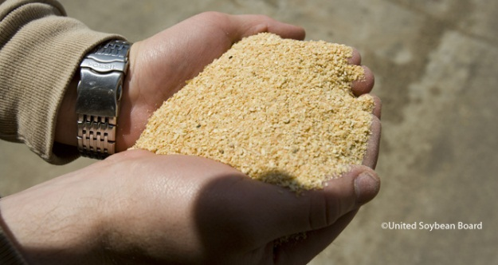
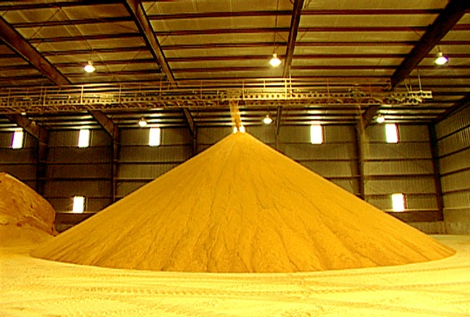
Proteins
Essential for growth. Necessary for building and repairing tissue, particularly muscle tissue
Sources
Soybean Meal
Distillers Grains (Dry and Wet)
Alfalfa Meal
Blood or Bone Meal (non-ruminant diets)

Slide 24
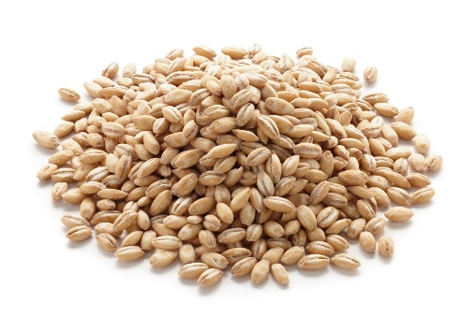
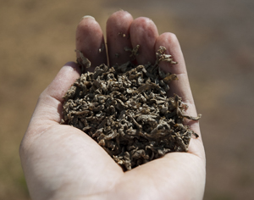
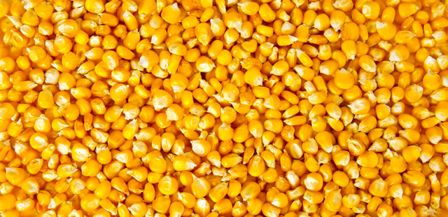
Carbohydrates
Necessary to provide energy to the diet
Sources
Silage (Barley, Corn, and Alfalfa
Barley
Corn
Beet Pulp

Slide 25
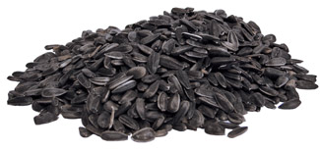
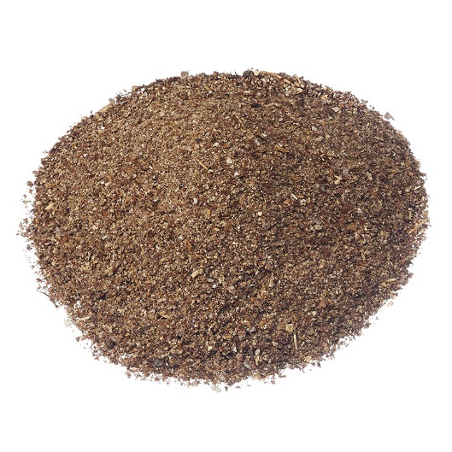
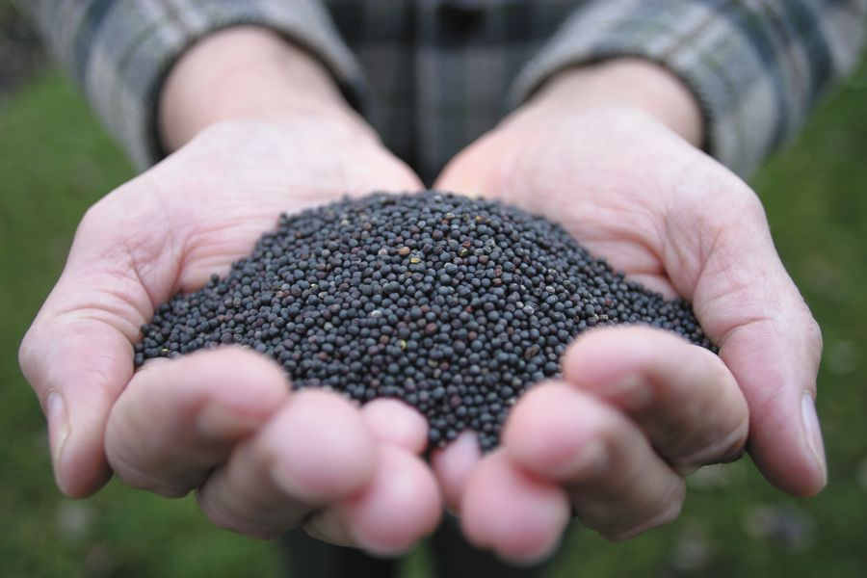
Fats
Often added to increase the energy of the ration
Sources
Canola
Cottonseed
Linseed
Sunflowers

Slide 26
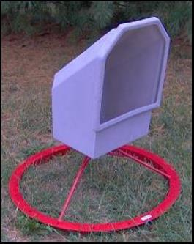
Minerals
Free Choice to provide necessary levels of Macro and Micro minearals
Macrominerals: calcium, chloride, iron, magnesium, sodium, potassium, phosphorus and sulfur.
Microminerals: chromium, cobalt, copper, fluoride, iodine, iron, manganese, selenium and zinc

Slide 27
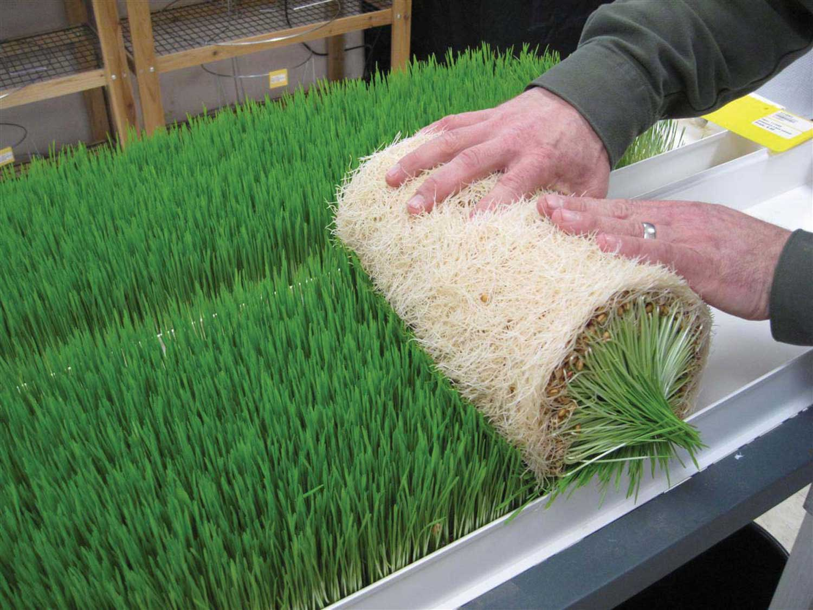
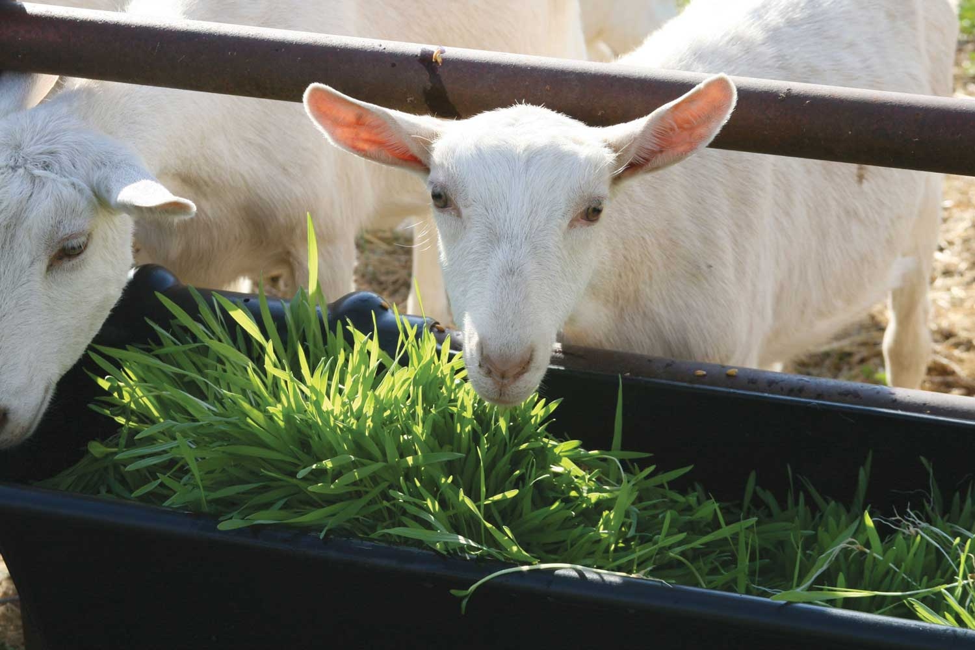
Vitamins
Sources:
Plant based feedstuffs (Alfalfa, Corn, Barley, Wheat, Oats, etc)

Slide 28
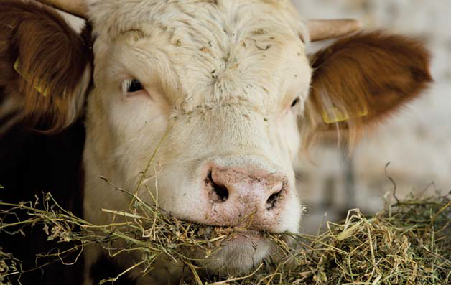
How Digestion Works
Digestion is the process of breaking down food
There are two types of digestion
Mechanical digestion
Chemical digestion
©iStock.com/Jevtic

Slide 29
The Basics of Digestion
All mammals have a similar digestive journey
Step 1: Food is taken through the mouth
Step 2: Food travels down the esophagus to the stomach
Step 3: Food passes into the small intestine
Step 4: The large intestine allows for continued absorption of nutrients
Step 5: Excess product leaves the body through the rectum and anus

Slide 30
Types of Digestive Systems
The different types of digestive systems are driving factors in the proper feeding of animals
The types of digestive systems
Ruminant
Monogastric
Modified monogastric
Avian

Slide 31
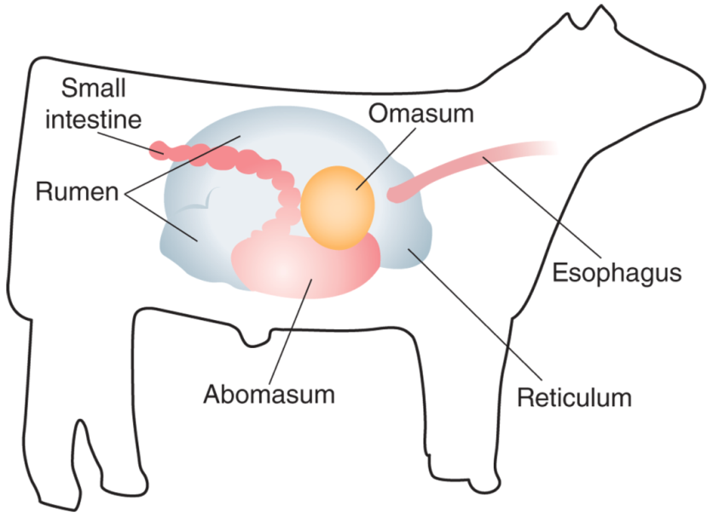
Ruminant Digestive Systems
A ruminant system has four compartments to its stomach
Rumen
Reticulum
Omasum
Abomasum
TAMU Livestock Judging

Slide 32
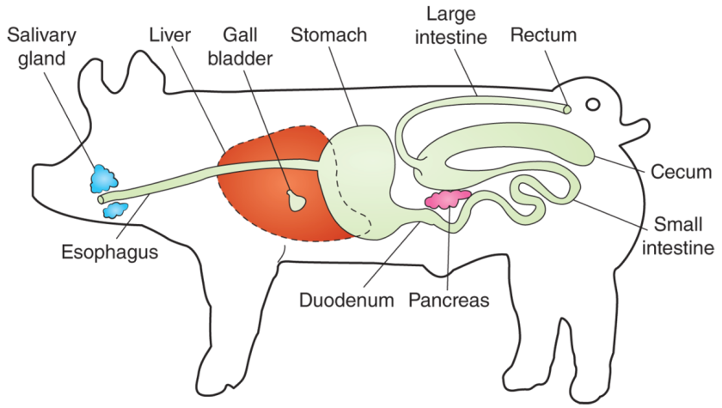
Monogastric Digestive System
A monogastric digestive system has a single compartment
Animals with monogastric systems do not perform well when fed high-roughage diets
TAMU Livestock Judging

Slide 33
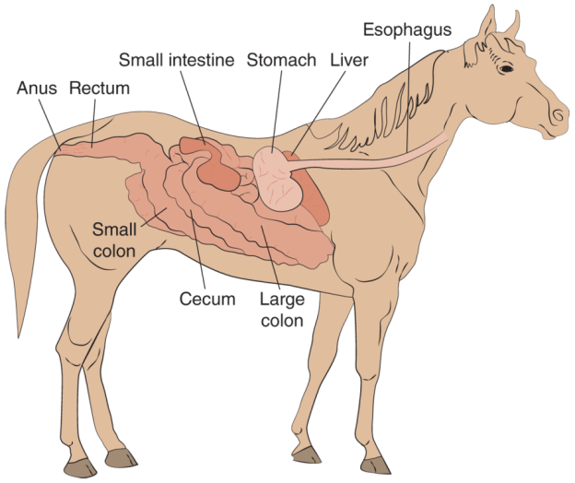
Modified Monogastric
A modified monogastric digestive system has a single compartment stomach and an enlarged cecum for microbial digestion
The cecum is a pouch-like area found at the beginning of the large intestine

Slide 34
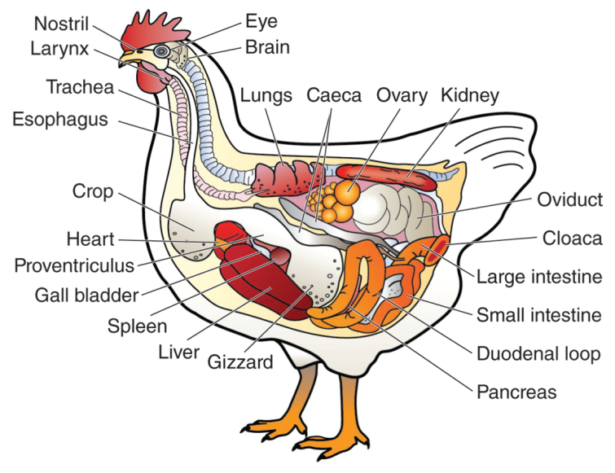
Avian Digestive System
The avian digestive system is the digestive system used by poultry and all birds
Poultry CRC

Slide 35
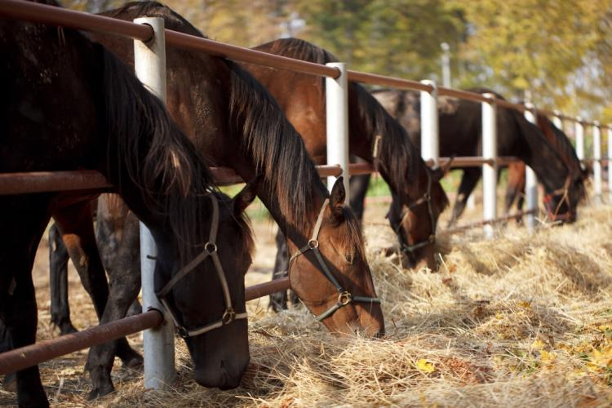
Digestive Disorders
Proper feeding is critical to avoid digestive disorders
Digestive disorders are one of the leading causes of death in all livestock animals
Dimedrol68/Shutterstock.com

Slide 36
Acidosis
Acidosis is caused when the pH level of a ruminant animal remains acidic for an extended period of time
This disorder is usually due to rapid intake of highly digestible concentrates

Slide 37
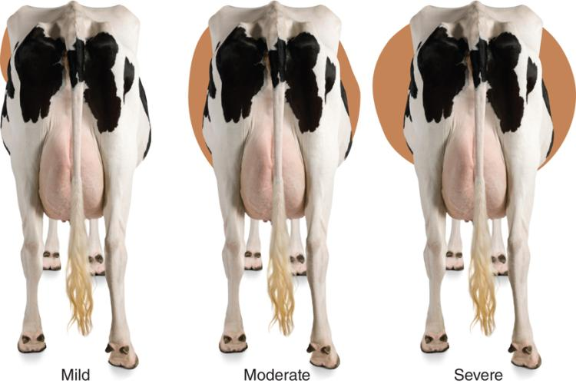
Bloat
Bloat is a condition in livestock animals where excessive gases build up in the rumen
May be caused by an obstruction, or by a buildup of froth preventing gas from being belched
©iStock.com/GlobalP

Slide 38
Colic
Colic is a digestive disorder that is the number one cause of death in horses
Colic basically means any digestive pain in horses
Colic can be caused by
Poor quality of feed
Twisted intestines
Ingestion of sand
When the horse is hot and drinks excessive amounts of water

Slide 39
Scours
Scours is a digestive disorder characterized by extreme diarrhea in young animals
Scours causes more loss of young animals than any other condition
Bacterial and viral digestive infection is a leading cause of scours
Hydration is key to recovery

