Slide 1
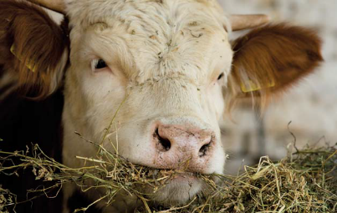
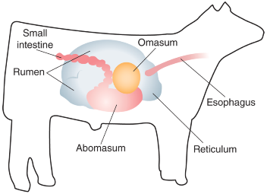
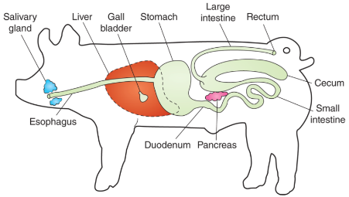
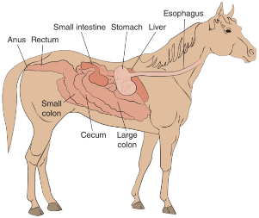
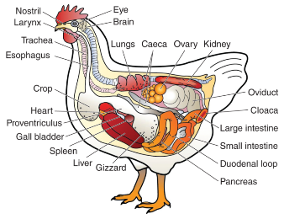
DIGESTION & DIGESTIVE SYSTEMS OF LIVESTOCK

Slide 2
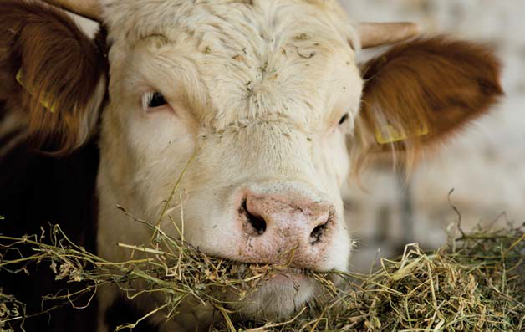
How Digestion Works
Digestion is the process of breaking down food
There are two types of digestion
Mechanical digestion
Chemical digestion
©iStock.com/Jevtic

Slide 3
The Basics of Digestion
All mammals have a similar digestive journey
Step 1: Food is taken through the mouth
Step 2: Food travels down the esophagus to the stomach
Step 3: Food is broken down chemically in the stomach
Step 4: Food passes into the small intestine where absorption occurs
Step 5: The large intestine allows for continued absorption of nutrients
Step 6: Excess product leaves the body through the rectum and anus

Slide 4
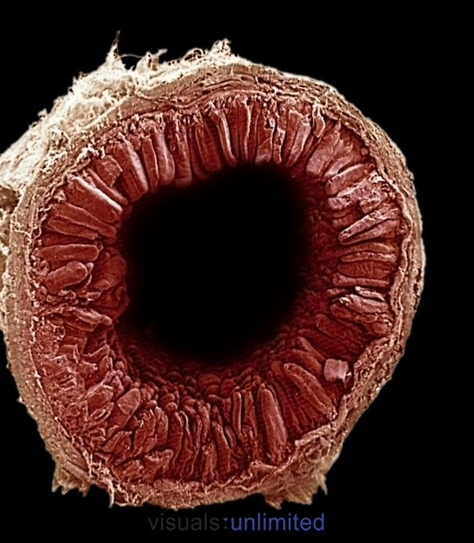
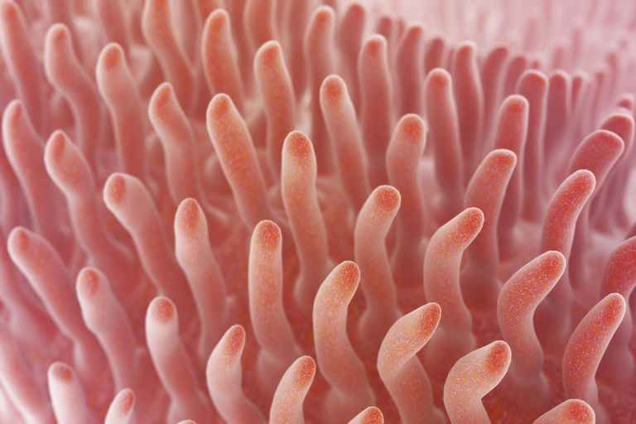
The Basics of Digestion
Most absorption of feed takes place inside the small intestine. Villi, millions of finger like projections on the walls of the small intestine are the key to absorption.
The Villi increase the surface area of the small intestine
Each Villus (Singular for Villi) has a network of blood capillaries and a lymph vessel through which nutrients enter the blood stream.

Slide 5
Types of Digestive Systems
The different types of digestive systems are driving factors in the proper feeding of animals
The types of digestive systems
Ruminant
Monogastric
Modified monogastric
Avian

Slide 6
Ruminant Digestive Systems
A ruminant system has four compartments to its stomach
Rumen
Reticulum
Omasum
Abomasum
TAMU Livestock Judging

Slide 7
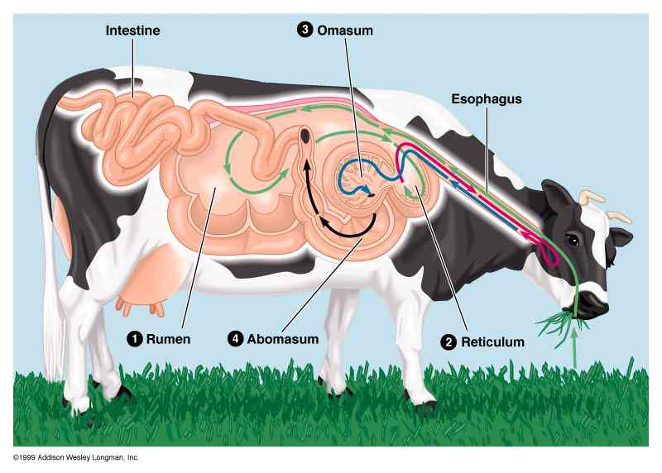
Ruminant Digestive Systems

Slide 8
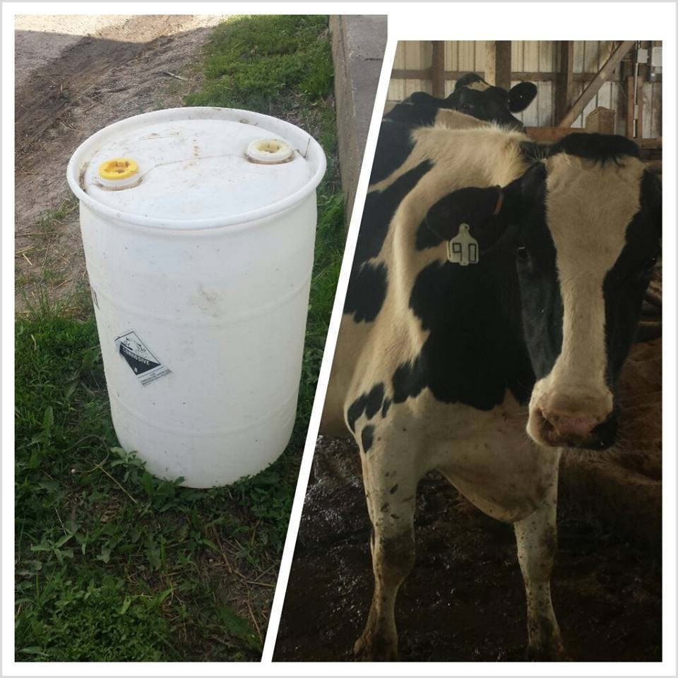
Ruminant Digestive Systems

Slide 9
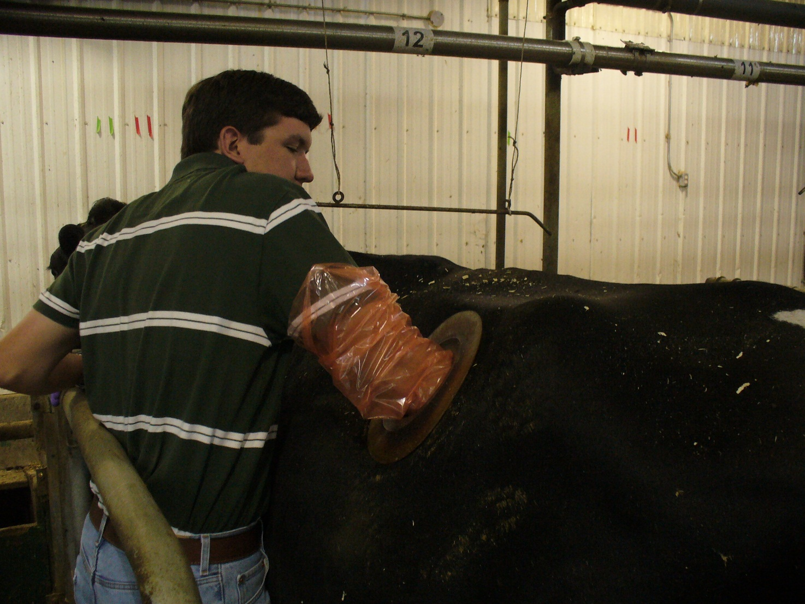
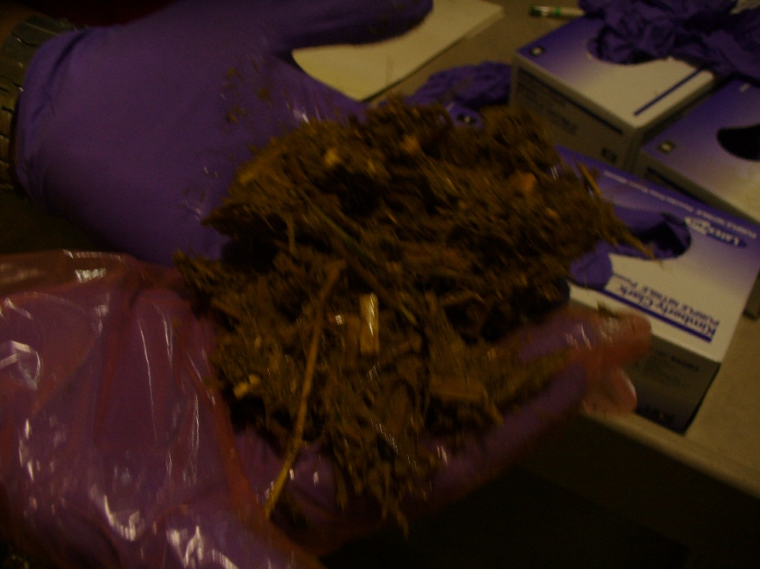
Ruminant Digestive Systems

Slide 10
Ruminate Digestive Systems

Slide 11
Ruminant Digestive Systems
Examples of animals with a ruminant digestive system include:
Cattle
Sheep
Goats
Buffalo
Deer
Elk
Giraffes
Camels
TAMU Livestock Judging

Slide 12
Monogastric Digestive System
A monogastric digestive system has a single compartment
Animals with monogastric systems do not perform well when fed high-roughage diets
TAMU Livestock Judging

Slide 13
Monogastric Digestive System
Examples of animals with a Monogastric digestive system include:
Swine
Dogs
Humans
Rats
Cats
Rabbits
Horses
TAMU Livestock Judging

Slide 14
Modified Monogastric
A modified monogastric digestive system has a single compartment stomach and an enlarged cecum for microbial digestion
The cecum is a pouch-like area found at the beginning of the large intestine

Slide 15
Avian Digestive System
The avian digestive system is the digestive system used by poultry and all birds
Poultry CRC

Slide 16
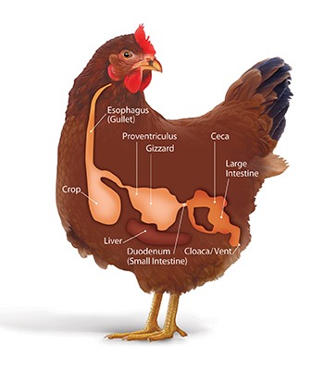
Avian Digestive System
The avian digestive system is the digestive system used by poultry and all birds

