Slide 1
Floriculture Disorders
National FFA Floriculture CDE

Slide 2
Directions for Floriculture Disorders
Pest and disorder items may be presented as an intact specimen, photograph or preserved specimen (herbarium sheet, insect mount, etc.).
Each specimen will be designated by a station number.
For each specimen the participant must:
determine the classification (nutritional/ environmental, insect/ pest, or disease) of the disorder.
identify/ name the disorder correctly.
correctly give the chemical AND cultural controls for the disorder.
Each disorder is worth 5 points total – 1 point for correctly determining classification, 2 points for correctly identifying the disorder, 1 point for correctly labeling the chemical control, and 1 point for correctly labeling the biological control.
Each participant will identify 15 specimens total for this event.
No specimens or items may be touched or handled in any way.
Fifteen minutes will be allowed for this event.
Refer to the Disorder Practicum Scorecard for additional details.
National FFA Floriculture CDE

Slide 3
National FFA Floriculture CDE
.

Slide 4
Classification: NUTRITIONAL AND ENVIRONMENTAL DISORDERS
Footer description area.

Slide 5
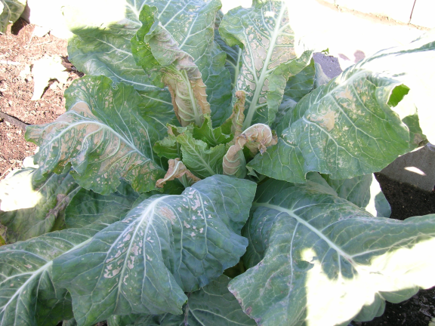
COLD TEMPERATURE (FREEZE)
Symptoms:
Cell damage occurs when plants are exposed to temperatures below their hardiness.
Chemical Control:
No Treatment Listed
Cultural Control:
Correct / Adjust Temperature

Slide 6
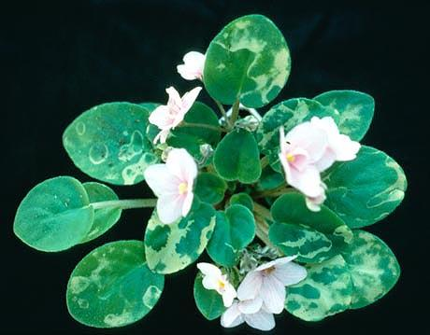
COLD WATER DAMAGE
Caused by watering the foliage of the plant with cold water.
Often occurs on plants with hairy leaves.
Chemical Control:
No Treatment Listed
Cultural Control:
Correct/ Adjust Temperature

Slide 7
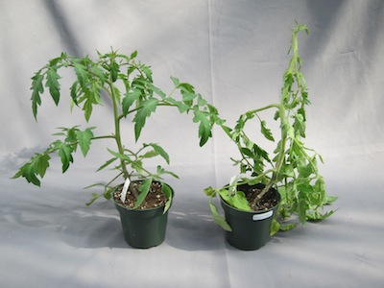
ETHYLENE DAMAGE
(plant pictured on right)
Can cause a distorted corkscrew type of stem growth, curling of leaves, narrow leaves, abortion of buds and possible death of the plant.
Chemical Control:
No Treatment Listed
Cultural Control:
No Treatment Listed

Slide 8
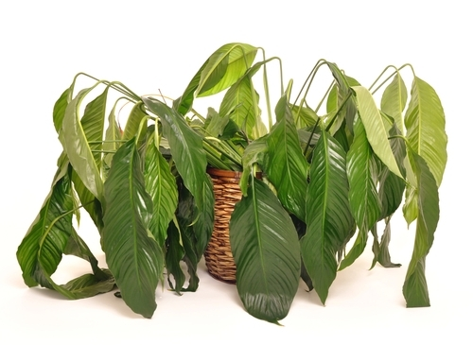
INSUFFICIENT WATER DAMAGE
Chemical Control:
No Treatment Listed
Cultural Control:
Correct/ Adjust Watering
Plant will show signs of wilt, thus retarding photosynthesis and slowing plant growth. The elongation of young developing cells is reduced resulting in smaller leaves and shorter stem internodes. In extreme cases, the cells of leaf or petal margins may die or leaves may abscise (fall off the plant).

Slide 9
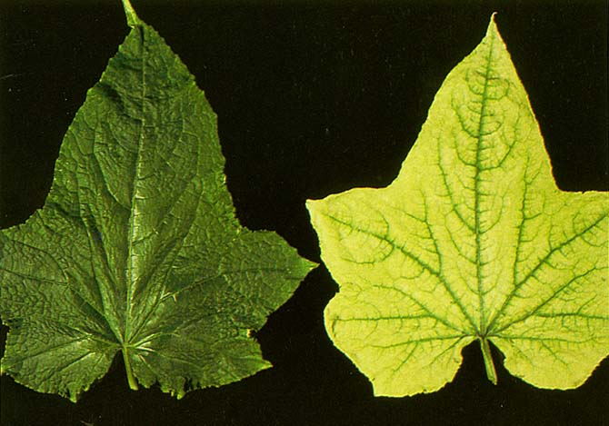
IRON DEFICIENCY
(leaf pictured on the right)
Interveinal chlorosis of young leaves. In late stages, the leaf blade may lose nearly all pigment taking on a white appearance and finally turning necrotic.
Chemical Control:
No Treatment Listed
Cultural Control:
Apply Complete Fertilizer

Slide 10
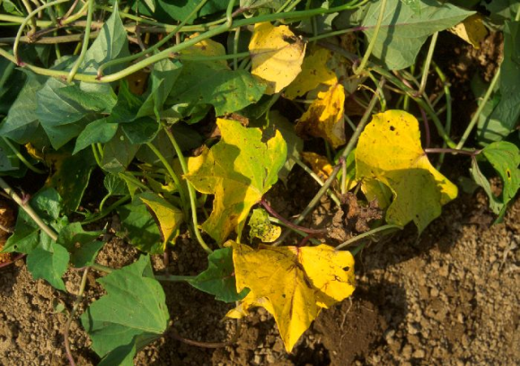
NITROGEN DEFICIENCY
The older leaves become uniformly chlorotic then progress to a solid yellow. After considerable time, older leaves become necrotic and drop off.
Chemical Control:
No Treatment Listed
Cultural Control:
Apply Complete Fertilizer

Slide 11
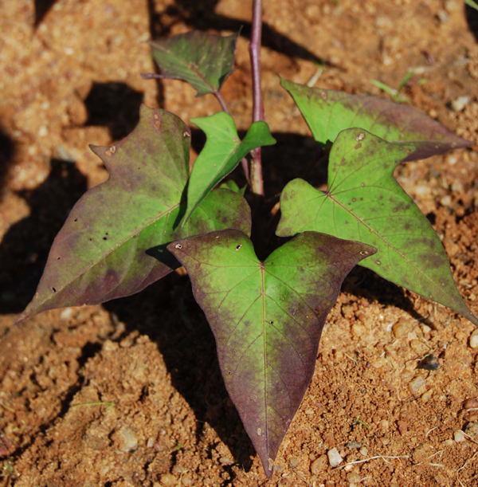
PHOSPHORUS DEFICIENCY
The plant becomes severely stunted and at the same time the foliage becomes deeper green than normal. The older leaves develop purple coloration.
Chemical Control:
No Treatment Listed
Cultural Control:
Apply Complete Fertilizer

Slide 12
Classification:
DISEASES

Slide 13
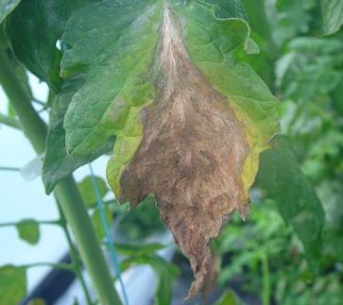
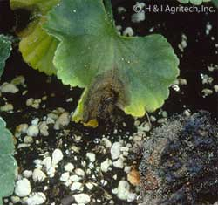
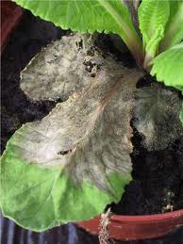
BOTRYTIS
Symptoms of Botrytis vary greatly depending on the host and plant part affected.
Generalized symptoms include a gray to brown discoloration and a fuzzy whitish gray to tan mold growing on the tissue surface
Chemical Control:
Fungicide
Cultural Control:
Reduce Relative Humidity
Also known as
“Gray Mold”

Slide 14
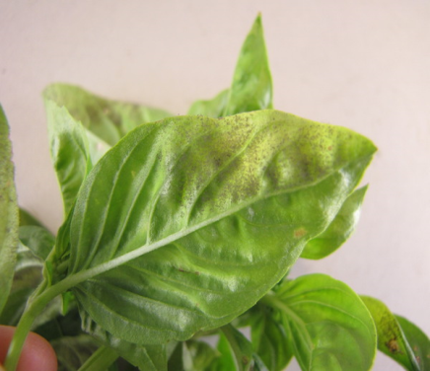
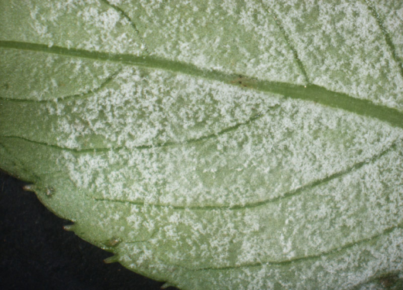
DOWNY MILDEW
Chemical Control:
Fungicide
Cultural Control:
Reduce Relative Humidity
Downy mildew colonies often appear first on the underside of leaves, and they sometimes have a bluish tinge. In many cases, they can grow systemically throughout the plant.

Slide 15
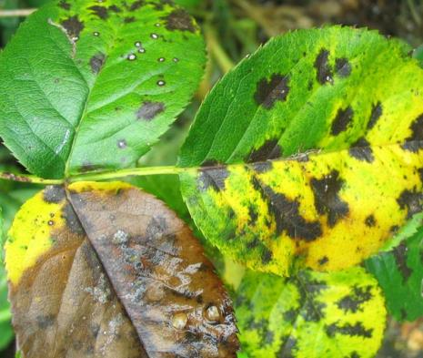
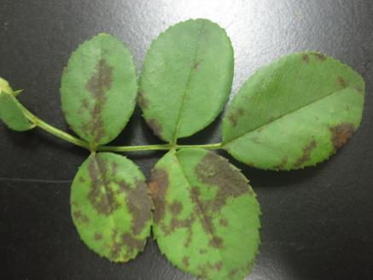
BLACK SPOT
Chemical Control:
No Treatment Listed
Cultural Control:
Correct/ Adjust Watering
Brown or black circular or angular areas of dead tissue.
This disease infects the leaves and greatly reduces plant vigour.

Slide 16
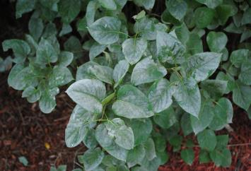
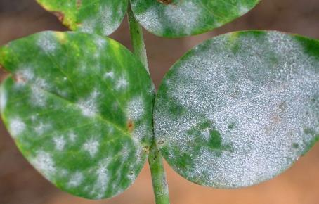
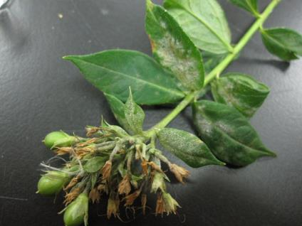
POWDERY MILDEW
Mold that is white/gray in color
Flat mold that grows along the top surface of the leaf
Chemical Control:
Fungicide
Cultural Control:
Reduce Relative Humidity

Slide 17
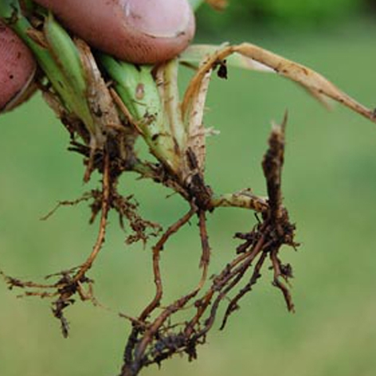
ROOT ROT
Growth of infected plants slows as compared to healthy plants. Older leaves yellow and drop. Margins of leaves die.
Roots appear dark brown or black and few or no white roots or root tips can be found when the root ball is washed free of soil.
Chemical Control:
Fungicide
Cultural Control:
Correct/ Adjust Watering

Slide 18
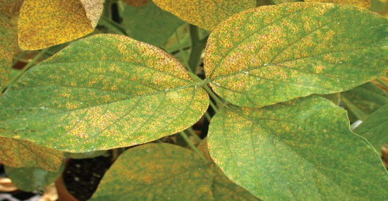
RUST
Pale leaf spots eventually develop into spore- producing structures called pustules. The pustules are found most commonly on the lower leaf surface and produce huge numbers of microscopic spores. Pustules can be orange, yellow, brown, black or white.
Chemical Control:
Fungicide
Cultural Control:
Correct/ Adjust Watering

Slide 19
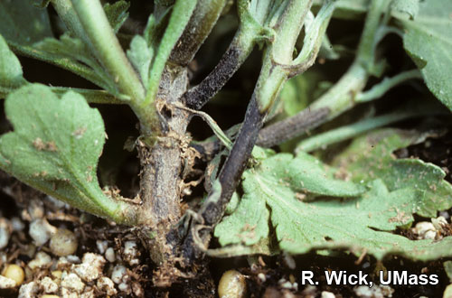
STEM ROT
Spots of various sizes occur on the stem, at or near the soil level and on the roots. These spots may vary in color from gray, brown, black, or even bright red. Frequently, these fungi cause the tips of fibrous roots to decay. Wilting, dieback, and poor vigor are common symptoms.
Chemical Control:
Fungicide
Cultural Control:
Correct/ Adjust Watering

Slide 20
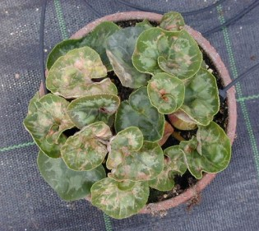
TOSPOVIRUS (INSV AND TSWV)
The most common symptoms of virus infection are stunting or dwarfing. Leaves may also show distinctive symptoms such as spots, streaks, blotches, and rings of light green, yellow, brown, or black or they may develop uniform yellow or orange coloration. Leaves also may change in size or shape, either puckering or developing rolled margins.
Chemical Control:
No Treatment Listed
Cultural Control:
No Treatment Listed

Slide 21
Classification:
INSECTS AND PESTS

Slide 22
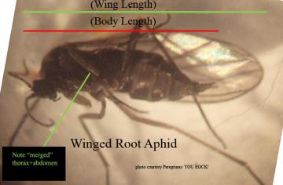
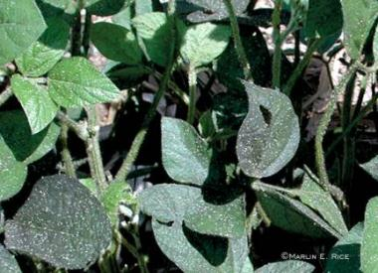
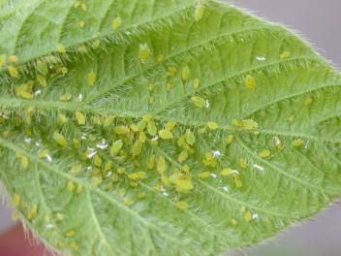
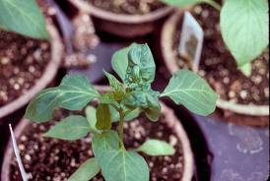
APHIDS
Always appear in large groups, can be many different colors and sizes
Produces a sap (honeydew) that promote the growth of black sooty mold (seen below)
Chemical Control:
Insecticide
Cultural Control:
Ladybird Beetles
Can also cause leaf curling/ distortion on new growth

Slide 23
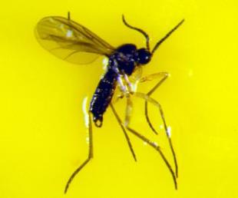
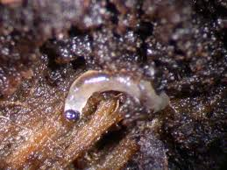
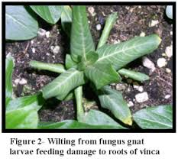
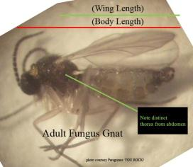
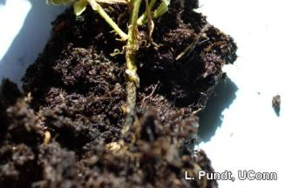
FUNGUS GNAT
Looks like a small fly and has very long antennae. Wings have a y-shaped vein.
Fungus Gnat larvae feed on the roots of the plants
Chemical Control:
Insecticide
Cultural Control:
Nematodes

Slide 24
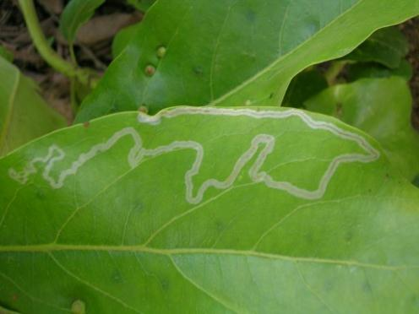
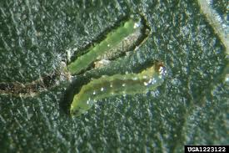
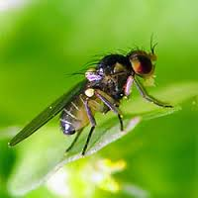
LEAF MINER
Leafminer larvae
Chemical Control:
Insecticide
Cultural Control:
Parasitic Wasps
Leafminer mining damage
Leafminer adult

Slide 25
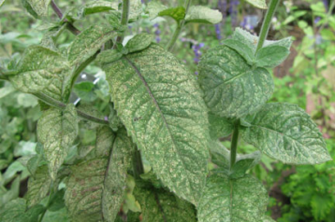
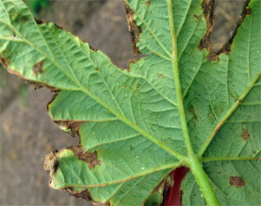
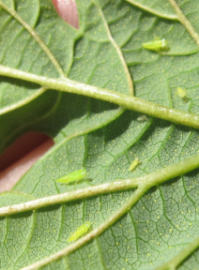
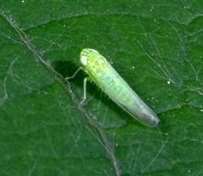
LEAFHOPPER
Feeding damage from some species causes small white spots (stippling) to appear on the upper leaf surface, usually beginning near the leaf midrib.
Stippled areas can unite into larger whitish blotches on mature leaves. With some plants, feeding damage causes a drying and yellowing (or browning) of leaf margins, and possibly the whole leaf. Some leafhopper species cause curling or stunting of terminal leaves with their feeding.
Chemical Control:
Insecticide
Cultural Control:
Parasitic Wasps

Slide 26
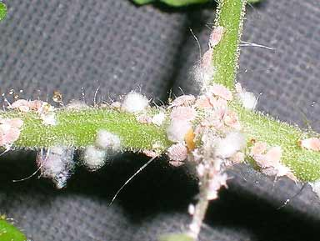
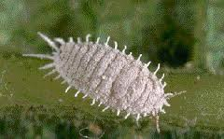
MEALYBUGS
White in color, they usually start in small groups.
Mealybugs feed by sucking plant juices which weakens the plant and causes the plant’s leaves to turn yellow, wilt and drop. The insects also produce honeydew, a sticky substance that increases sooty mold growth on plants and attracts feeding ants.
Chemical Control:
Insecticide
Cultural Control:
No Treatment Listed
(Lady Beetles & Parasitic Wasps are not considered a cultural control because they have not been deemed effective.)
The webbing around some is the female laying eggs or an already formed egg mass

Slide 27
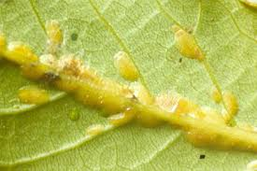
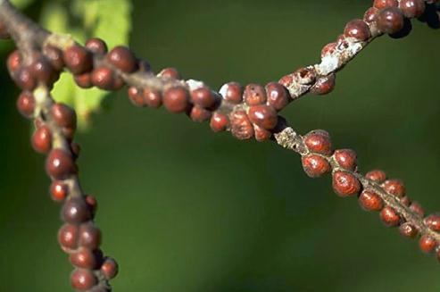
SCALE
Scale can be found on the stems of the plant and the underside of the leaves. Scale can be several different colors. Scale can also be flat bodied and sit very close to the plant or sit more raised up on the surface.
The scale insects infest both the leaves and the stems of the host plants, and feed by inserting needle-like mouthparts into the plant tissue and sucking out plant sap. Feeding injury may result in poor growth and stunted plants.
Chemical Control:
Insecticide
Cultural Control:
No Treatment Listed
(Parasitic Wasps are not considered a cultural control because they have not been deemed effective.)
Hard bodied scale
Soft bodied scale

Slide 28
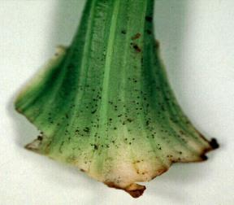
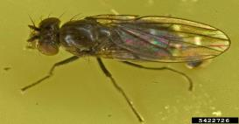
SHORE FLIES
Shore Flies deposit characteristic black "fly specks” on foliage that are unsightly. Larvae are considered algae feeders, and do not feed on crop plant tissue. Adult shore flies are capable of transmitting Pythium and other root disease organisms.
Algal growth and shore flies are common in misted propagation areas, and diseases are particularly severe to young plants during propagation.
Chemical Control:
Insecticide
Cultural Control:
Correct/ Adjust Watering

Slide 29
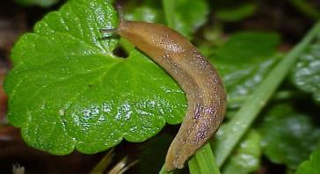
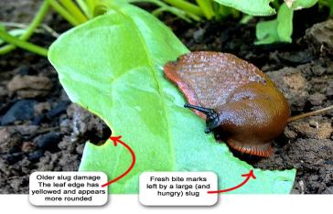
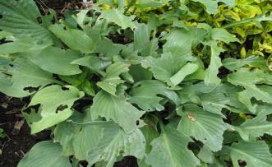
SLUG
Unsegmented, soft, and slimy body – does not have a shell.
Slugs sometimes leave behind slime trails, which can be seen as a silvery deposit on hard surface, leaves and stems. Slugs can make irregular holes in plant tissue with their rasping mouth parts. They can kill young seedlings by completely eating them.
Chemical Control:
Mulluscicide
Cultural Control:
Nematode
Slug damage

Slide 30
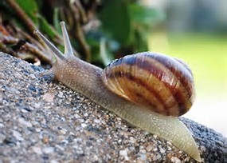
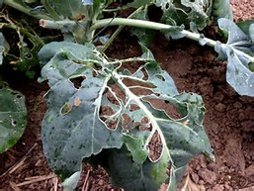
SNAIL
Chemical Control:
Mulluscicide
Cultural Control:
No Treatment Listed
Snails, which have shells, sometimes leave behind slime trails, which can be seen as a silvery deposit on leaves, stems, soil and hard surfaces
Snails make irregular holes in plant tissues with their rasping mouthparts. Young shoots and leaves are damaged or eaten, not only at ground level but often high up.

Slide 31
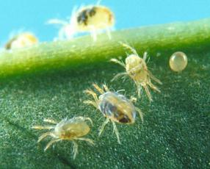
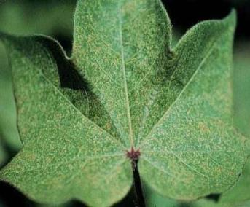
SPIDER MITES
Notice speckling on the leaves from spider mite damage
Appear in large groups and adults have 8 legs
Also produce webbing between leaves of plant
Chemical Control:
Miticide
Cultural Control:
Predatory Mites
Symptoms of injury include flecking, discoloration (bronzing) and scorching of leaves. Injury can lead to leaf loss and even plant death.

Slide 32
THRIPS
Tiny, hard to see without a lens, dark bodies insect
Chemical Control:
Insecticide
Cultural Control:
Predatory Mites
Thrips feeding on plants can damage fruit, leaves, and shoots and affect plants’ cosmetic appearance.
Thrips feeding can stunt plant growth and cause damaged leaves to become papery and distorted, develop tiny pale spots (stippling), and drop prematurely.
Petals may exhibit color break which is pale or dark discoloration of petal tissue that was killed by thrips feeding before buds opened. On some plants thrips can cause severe stunting to the early season flush of terminal growth.
Feeding damage on the petals of a flower
Often can be found inside the actual flowers of the plant
Damage to a florist chrysanthemum leaf
Damage on blueberries

Slide 33
WHITEFLY
The most obvious whitefly feeding damage symptoms are stem blanching, chlorotic spots, leaf yellowing and shedding, and plant death.
Whiteflies are small, white, winged insects.
Are normally found on the underside of the leaf
Lay eggs on the bottom of leaves, often egg castings (remains) are still visible even after they have hatched
Chemical Control:
Insecticide
Cultural Control:
Parasitic Wasps

Slide 34
KEY REFERENCE
Greenhouse Operation and Management – Paul V. Nelson – Pearson/ Prentice Hall (Specific Reference for the disorders rotational practicum)

