Slide 1
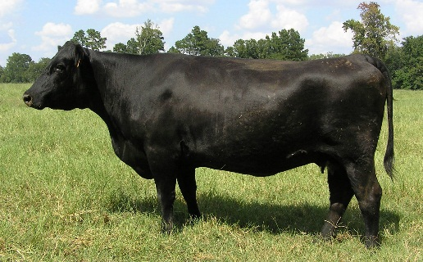
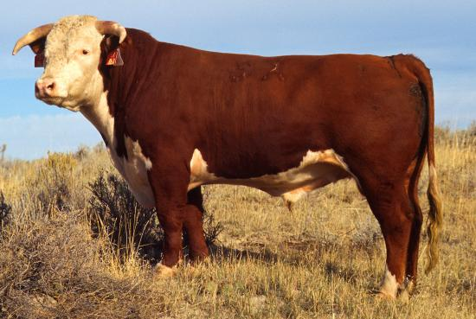
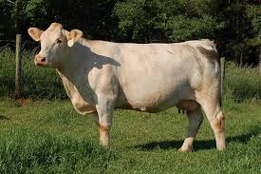
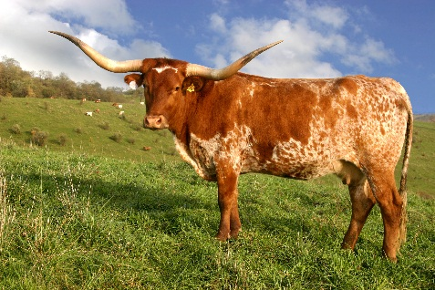
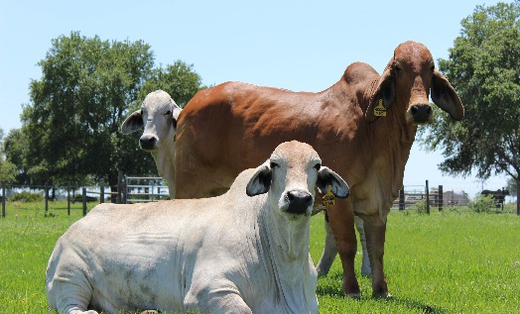
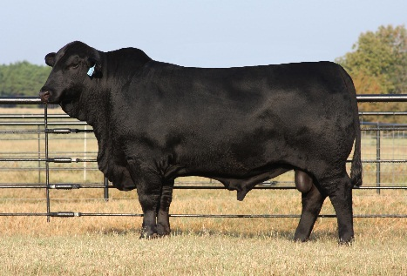
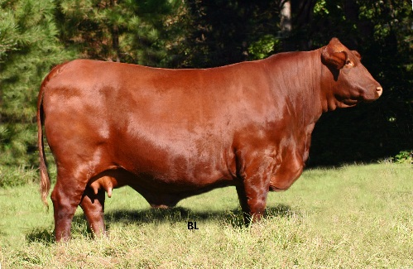
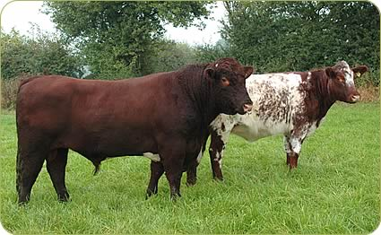
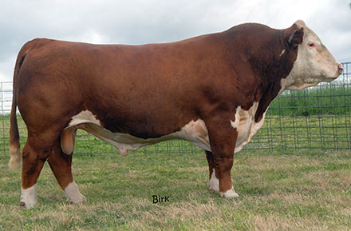
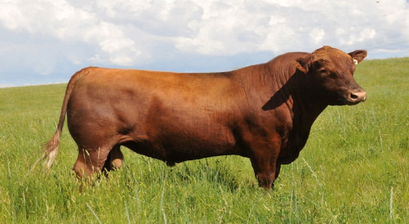
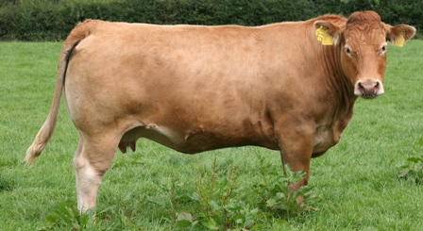
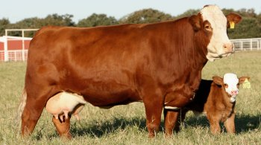
Breeds of Beef Cattle

Slide 2
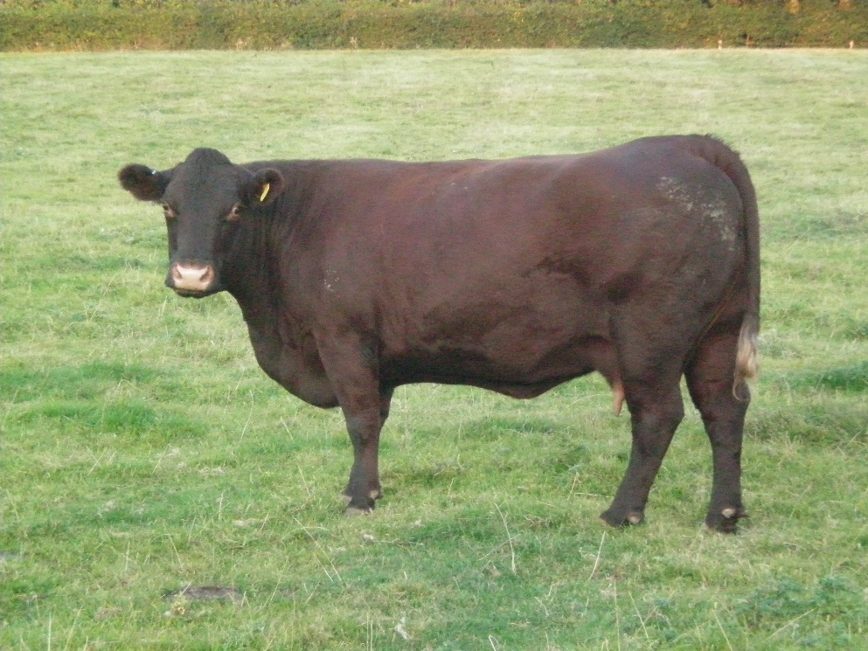
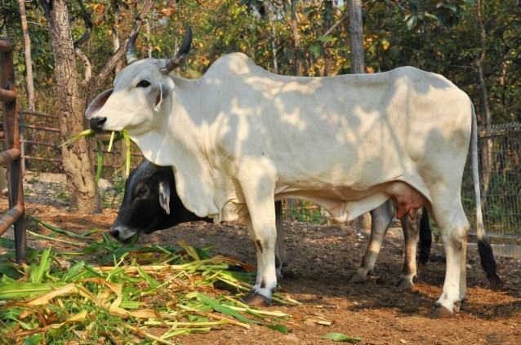
Bos Taurus
Bos Indicus
Cattle of European Descent
Cattle of Indian (Asian) Descent
“Eared Cattle”

Slide 3
Angus
Originated in England
Black Hide & Hair
Polled
High Quality Beef
Certified Angus Beef
Notes:
The first Angus cattle in the US were imported by George Grant around 1873. Angus are the most popular purebred cattle in the US due largely to CAB.
Angus are moderate cattle that yield carcasses with a high degree of marbling.

Slide 4
Hereford
Originated in England
Red w/ 6 White Points
Horned
Know for efficiency and foraging ability
Notes:
Hereford Cattle originated in Hereford County in England. The first Hereford cattle in the US were imported by Henry Clay to Kentucky. The first purebred Hereford herd was believed to be established around 1840 in New York.
Instrumental in improving cattle in the west.

Slide 5
Polled Hereford
Developed in the US
Red w/ 6 White Points
Polled
Know for efficiency and foraging ability as well as docility & maternal ability
Heavily used in crossbreeding programs
Notes:
Established in Iowa in 1901 by Warren Gammon. Gammon located 4 Hereford Bulls and 10 Hereford cows that carried the polled gene and mated them to form the breed.
Gammon Barn @ Iowa State Fair w/ Polled Hereford Hall of Fame

Slide 6
Shorthorn
Developed in Northern England
Red, White, or Roan
Dual Purpose Breed
Can be either polled or horned
Notes:
One of the oldest breeds of pure-bred cattle. Developed around 1600 in Northern England. First imported to Virginia in 1783. Typically have a great disposition and are good milkers and very maternal.

Slide 7
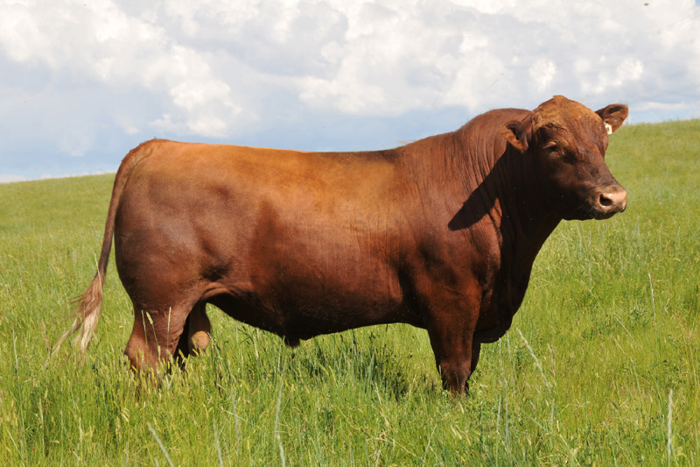
Red Angus
Developed in the US
Solid Red
Developed from Angus Cattle
Know for efficiency as well as docility & maternal ability
Breed relies heavily on data
Notes:
Established by a group of breeders in Montana, Wyoming, and Idaho in the 1950’s. Breed Association was formed in 1954. Established through mating of red, angus cattle. Tend to be more heat tolerant than angus cattle.

Slide 8
Charolais
Originated in France
White in Color
Very Expressively muscled cattle with high yields
Used heavily in crossbreeding programs to add muscle
Notes:
Old breed developed in central France. First imported to the US by the King Ranch in 1936. Was first imported to add frame size and muscling into cattle.

Slide 9
Limousin
Originated in France
Light yellow to Orange
High Cutability cattle
Notes:
First arrived in the US when semen was imported from Canada in 1968.
Lean carcasses with large loins.
Black Now

Slide 10
Simmental
Developed in Western Switzerland
Originally dual purpose
Cream colored face with a red, yellow, or spotted body
Large Framed, Lean Carcass
Notes:
Simmentals were brought to the US from Canada in 1969.
Originally in Switzerland they were used for make purposes including milk, meat, and draft.
Black Now

Slide 11
Longhorn
Developed from Mexican brush cattle
Very hardy cattle
Popular on the range
Today used as pasture pets and rodeo stock
Notes:
Brought from Mexico in the 1800s by Spanish Explorers.
Very High Fertility cattle
Slow growth but excellent foragers and very durable cattle’

Slide 12
Brahman
Developed in the US, but very similar to Zebu cattle of India
Can be gray to black and red
Developed in the mid 1800’s to early 1900’s
Hardy & Resistant cattle
Notes:
Well liked for their
Hardiness
Heat Tolerance
Resistance to Diseases & Insects
Foraging ability
Used in many crossbreeding situations and development of breeds
Un predicatable

Slide 13
Brangus
Developed in the US by LSU in 1912
Developed out of Angus and Brahman cattle
Heat Tolerant and High Quality beef
Original Seedstock were no less than 3/8 of either breed

Slide 14
Santa Gertrudis
Developed on the King Ranch in Texas around 1918
Deep Cherry Red
Polled
Crossing of Brahman and Shorthorn Cattle

Slide 15
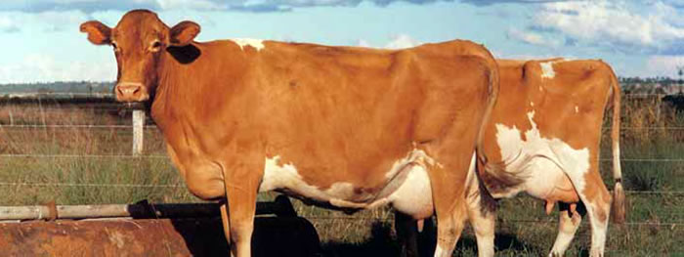
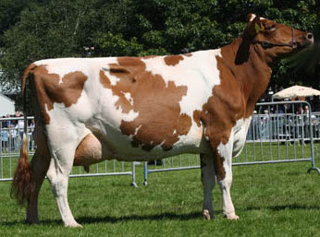
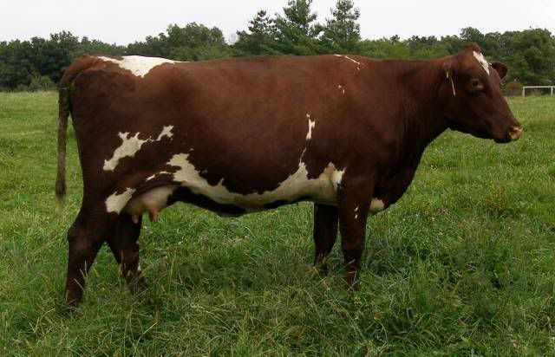
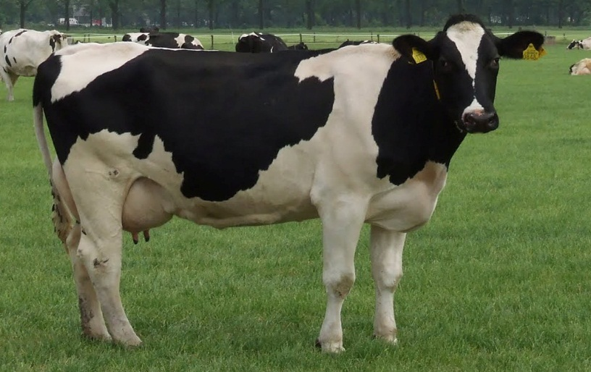
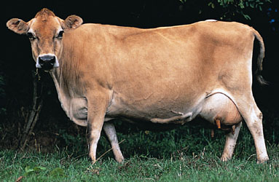
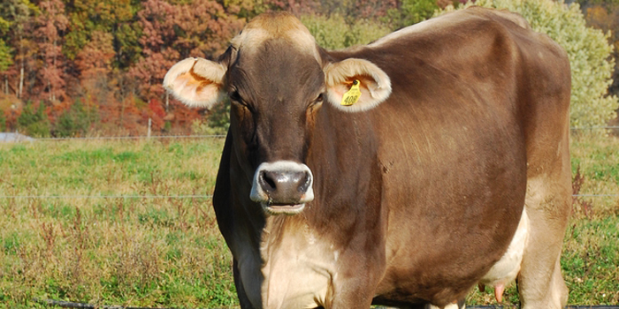
Breeds of Dairy Cattle

Slide 16
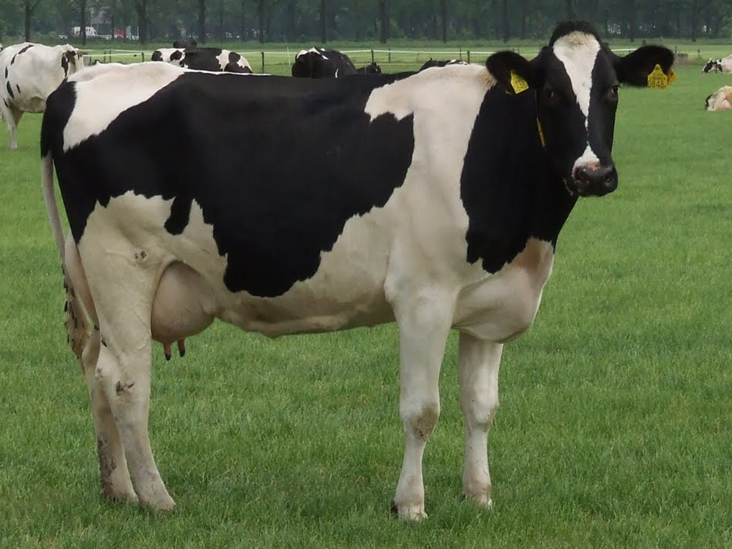
Holestien
Imported to the US from the Netherlands in 1621
Black and White in color
Most popular breed of dairy cattle in the US
Produce the largest quantities of milk
Large cows weighing 1,500 to 2,000 lbs

Slide 17
Jersey
Isle of Jersey
Grayish to fawn and near white in color
Smallest Dairy Breed
Imported to North America in 1850
Produce milk with high butter fat content

Slide 18
Guernsey
Imported from the Isle of Guernsey in 1831
Fawn with white markings
Give a golden color to their milk
Comparatively lower milk production

Slide 19
Ayrshire
Imported to the US from Scotland in 1822
Moderate framed dairy cattle
Color varies from light to dark red, brown, and white

Slide 20
Brown Swiss
Imported to North American from the Alps of Switzerland in 1869
Solid in color from light to dark brown with black nose and tongue
Favorable protein to fat ratio in milk

Slide 21
Milking Shorthorn
Recognized as a breed in 1968
Similar in to beef shorthorn in color
Dual Purpose Breed

