Slide 1
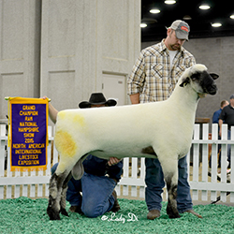
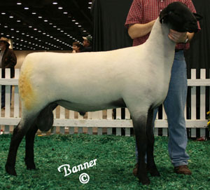
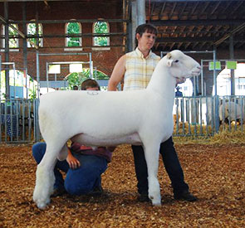
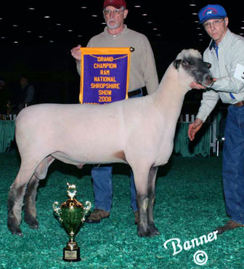
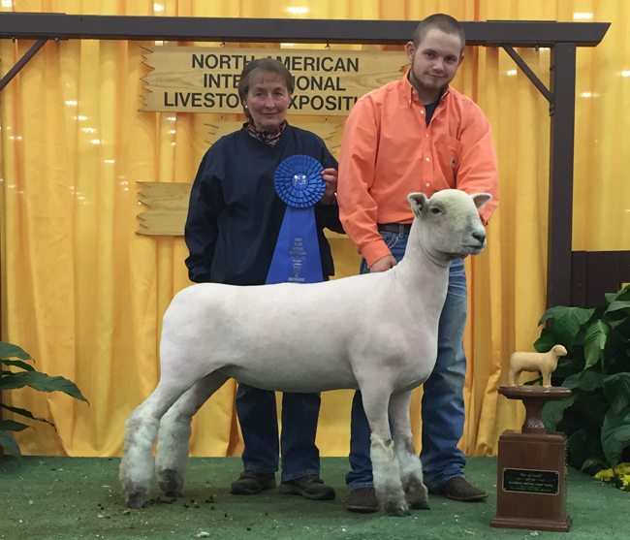
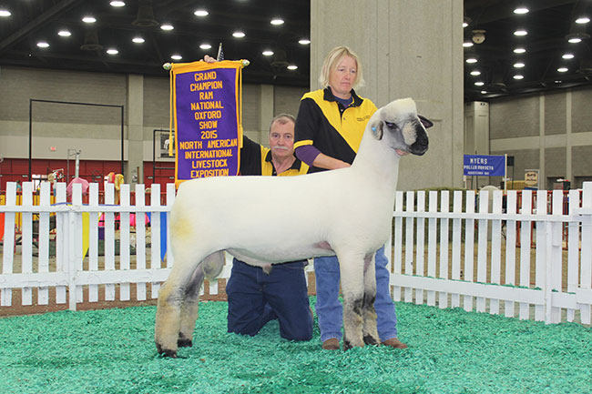
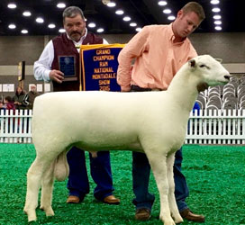
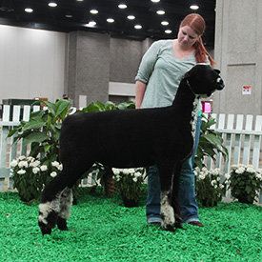
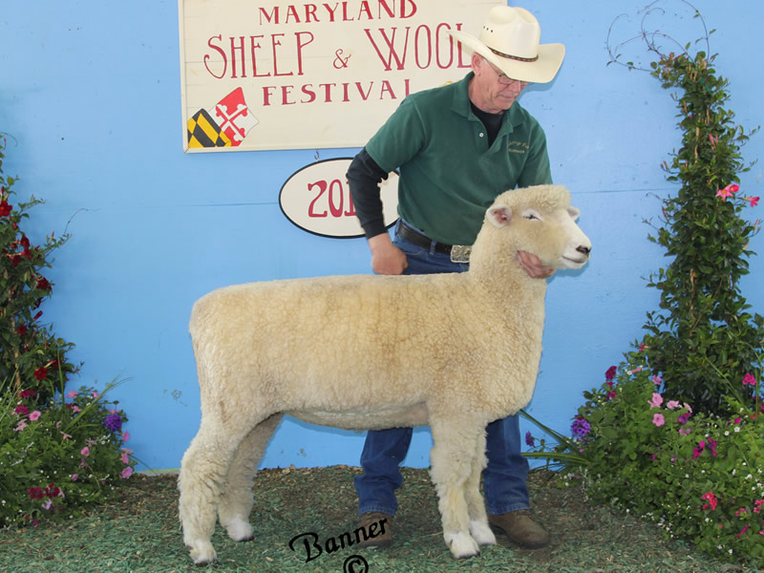
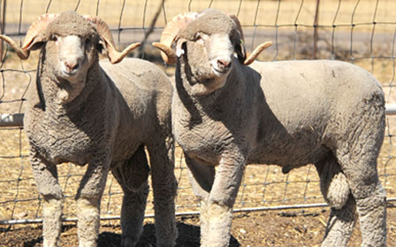
Breeds of Sheep

Slide 2
Breeds of Sheep
There are more than 150 different breeds of sheep
Sheep often categorized by wool type
Fine-wool
Long-wool
Medium-wool
Crossbred-wool
Hair sheep

Slide 3
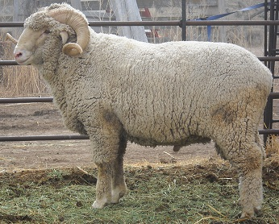
Fine Wool Breeds
All developed from the Spanish Merino breed
Valuable, fine wool
Common breeds
Rambouillet (shown)
Merino

Slide 4
Rambouillet
Notes:
Developed in France from Spanish Merino sheep
Large Wool Sheep

Slide 5
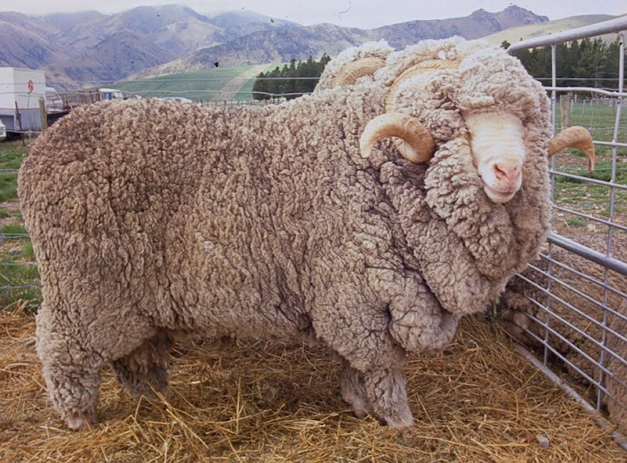
Merino
Notes:
One of the oldest breeds of sheep
Europe

Slide 6
Long Wool Breeds
Produce long, coarse wool
Originated in the United Kingdom
Long-wool breeds common in United States
Costwold
Leicester
Lincoln
Romney

Slide 7
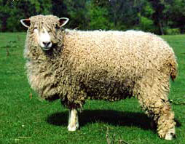
Cotswold
Notes:
Originated in Central England
Very old breed
Imported to the US in 1932
White faced wool sheep Wool will grow in chords

Slide 8
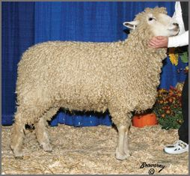
Linclon
Notes:
Originated in England but greatly improved in the US
One of the largest breeds of sheep
Wool will grow in chords.

Slide 9
Romney
Notes:
England
Small Wool Breed. Hardy sheep that are more resistant to foot rot than many other breeds
Imported to the US in 1972

Slide 10
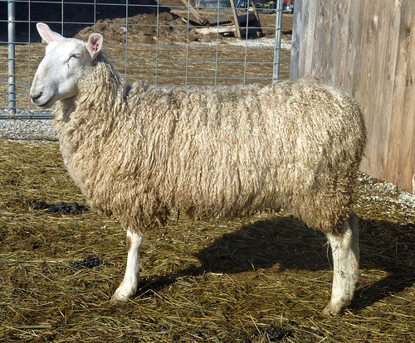
Border Leister
Notes:
Old breed of sheep with records as early as 1600 in England
Long wool breed
Closely related to the Cheviot

Slide 11
Crossbreed (Composite) Wool Breeds
Long-wool breeds crossed with fine-wool breeds
Popular crossbred-wool breeds
Columbia
Corriedale
Panama
Romeldale
Targhee
Tailess
Southdale

Slide 12
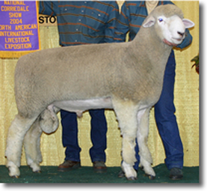
Corriedale
Notes:
Developed in New Zealand and Australia from Lincoln and Merino
Dual Purpose sheep
Imported to the US in 1914

Slide 13
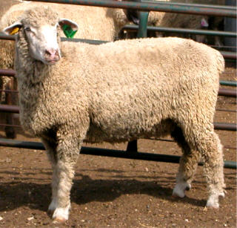
Columbia
Notes:
Developed in the US by USDA in the early 1900’s
Developed at the experiment station in Idaho by crossing Lincoln and Rambouillet

Slide 14
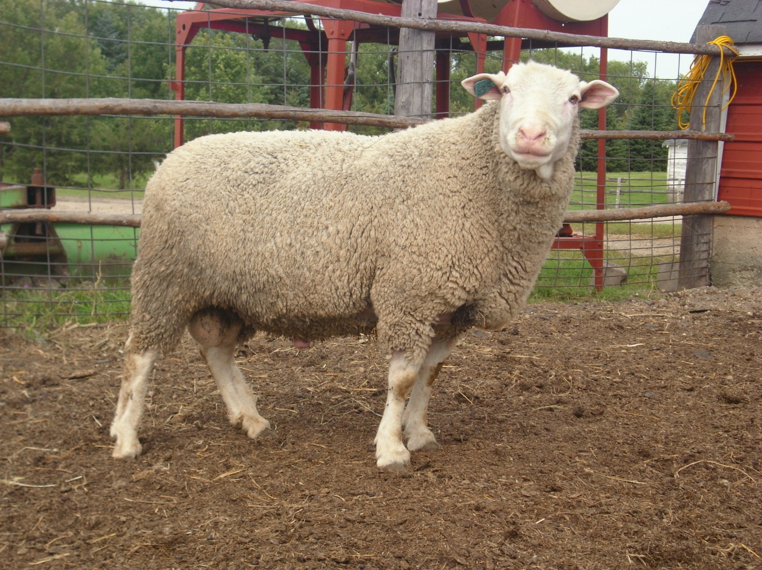
Polypay
Notes:
White faced wool sheep developed in the 1960s by USDA in Idaho. Developed from Ramouillet Targhee Finnsheep and Dorest
Noted for being hardy sheep that produce quality wool and meat

Slide 15
Medium Wool Breeds
Raised for lamb and mutton
Wool is secondary product
Popular breeds
Dorset
Hampshire
Southdown
Suffolk
Shropshire

Slide 16
Suffolk
Notes:
One of the largest Breeds of Sheep – mature weigh between 250-350 lbs
Large framed Black Faced Sheep with no wool on their heads or legs. Considered Med. Wool and raised for their meat
Imported from England in the 1880’s

Slide 17
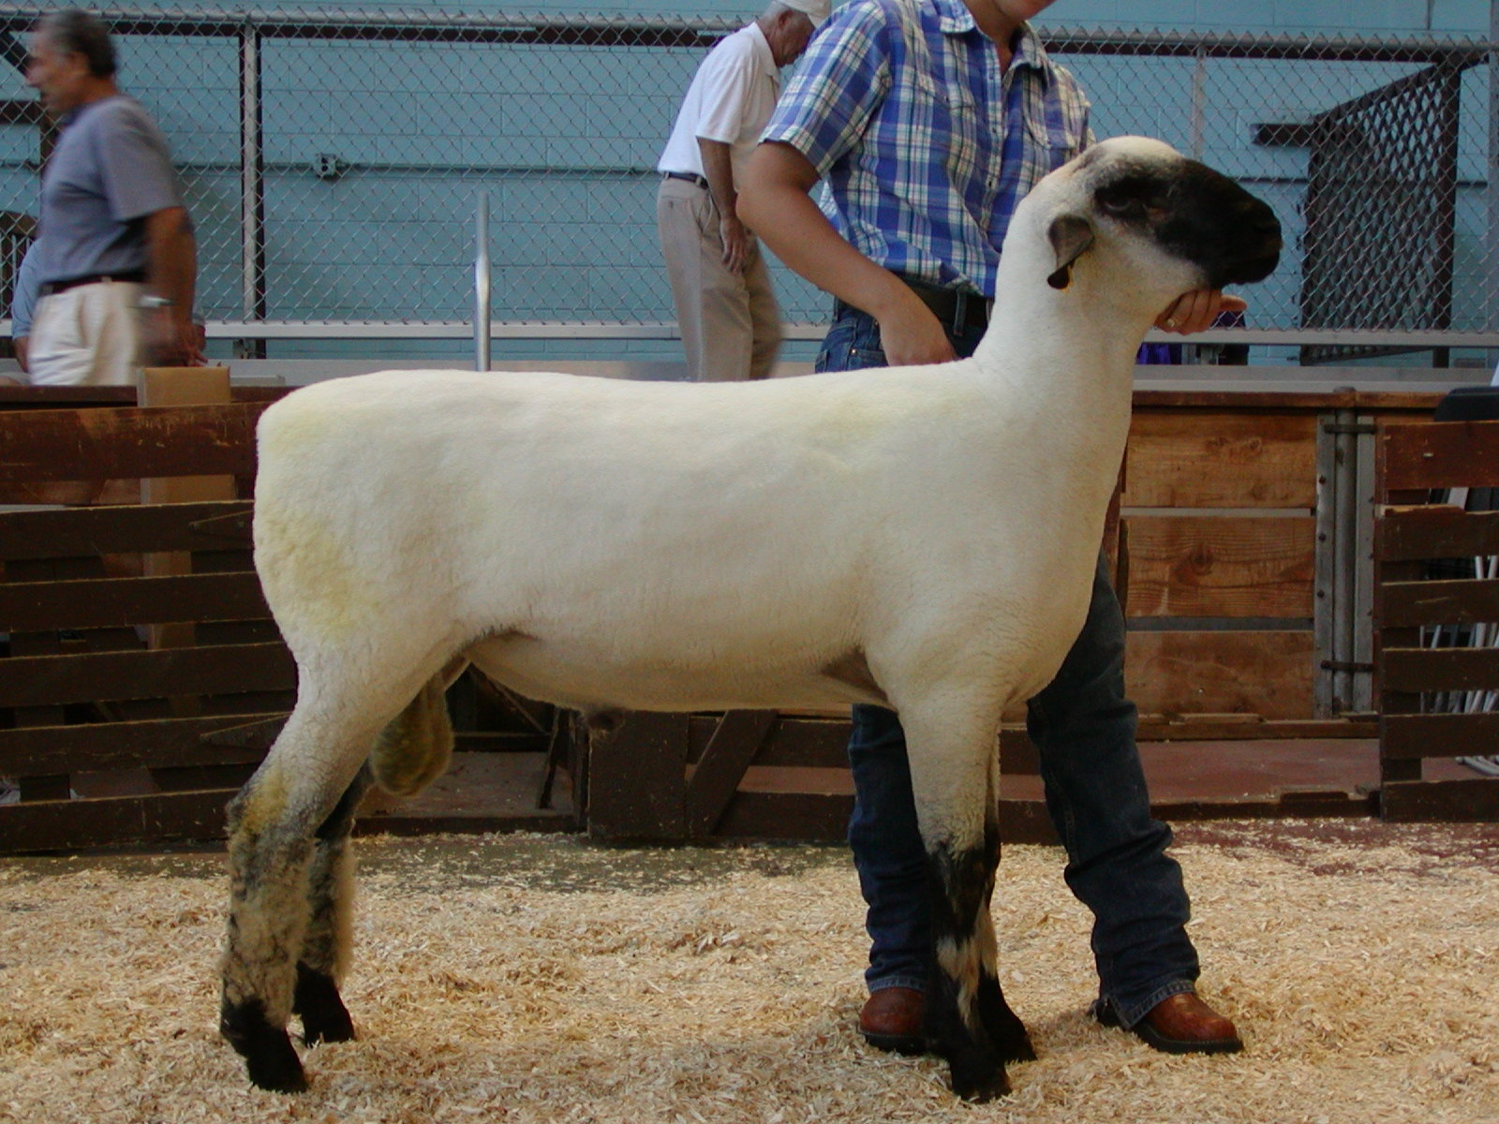
Hampshire
Notes:
Acquired name from Southern England where they were developed.
Records indicate they’re were Hampshire sheep in the US in the 1840’s but it is not clear they survived the Civil War. Imported again in the late 1860’s from England.
Hampshire is a large breed of sheep with a black face and wool on the head and legs.

Slide 18
Dorset
Notes:
Developed in England from crossing Spanish Merino Sheep with Horned Sheep of Wales
Polled Dorset sheep were developed at NC State in North Carolina
Dorsets were imported into the US in 1860 to Oregon
Dorsets are White faced sheep in fact they are the number one white faced sheep in the US and are used heavily in crossbreeding situations with both maternal and terminal goals.

Slide 19
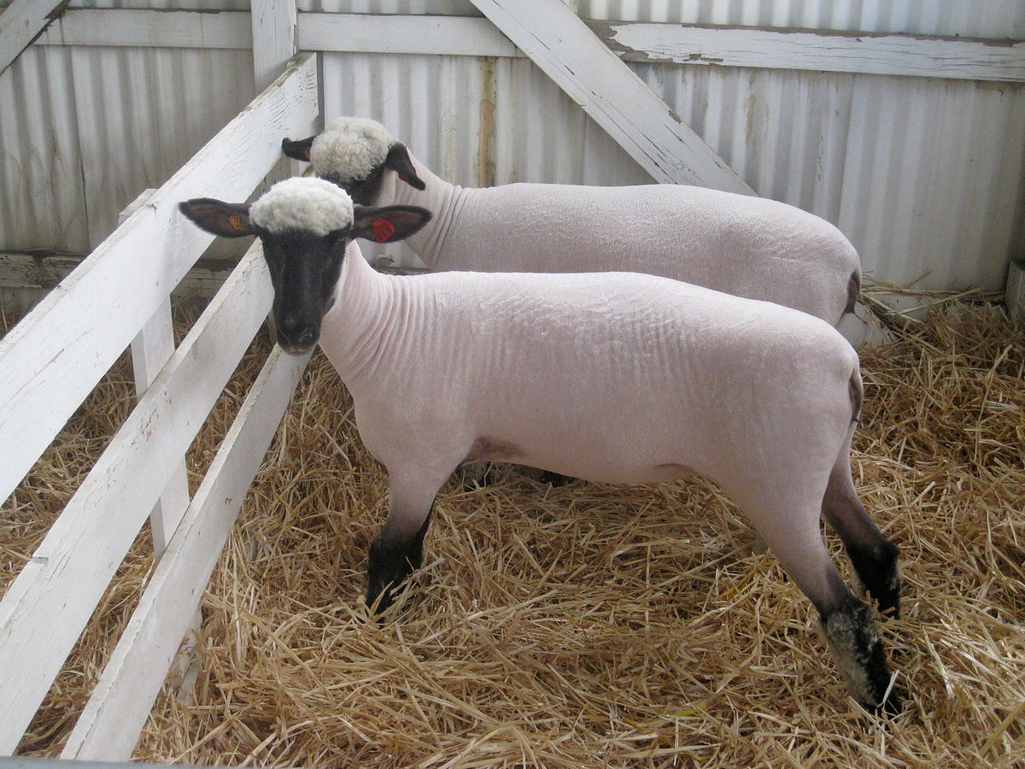
Shropshire
Notes:
Originated in the Shropshire and Staffordshire counties of England. First imported to the US in 1855 to Virgina.
Today Shrops are medium sized sheep that have strong carcass and meat quality. They are a relative early maturing sheep. Sheep are shown slick shorn to exhibit superior muscling and carcass quality
Gray to Black Face with wool from the tip of the nose to the hoof.

Slide 20
Oxford
Notes:
Originated in Oxford County England and was formed from breeding Hampshires and Cotswolds.
Produce the heaviest fleeces of most meat breeds
Black faced sheep with wool along the face, head, and legs

Slide 21
Montadale
Notes:
Developed from Columbia and Cheviot sheep. Developed in the US and the Montadale breed association was established in 1945.
Noted as dual purpose breed producing heavily muscled carcasses and wool with little lanolin.
Medium sized white faced sheep with a clean head and legs

Slide 22
Southdown
Notes:
Developed in Sussex England during the late 1700’s and early 1800’s.
Small sized sheep with a grey to mouse-brown face and lower legs and is polled. Shown slick shorn
Feed Efficient sheep that mature early with good carcass quality

Slide 23
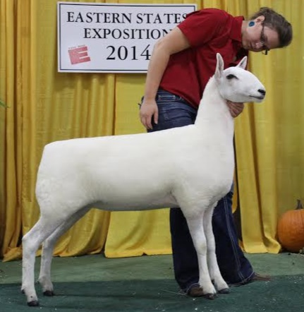
Cheviot
Notes:
One of the oldest know breeds of sheep originated in the Cheviot Hills region along the England Scotland border in the 1300’s.
Distinctive White face with wool-free head and legs, pricked ears, Black muzzle and black feet. Noted for being very alert and active sheep.
Small sheep maturing at 200 lbs

Slide 24
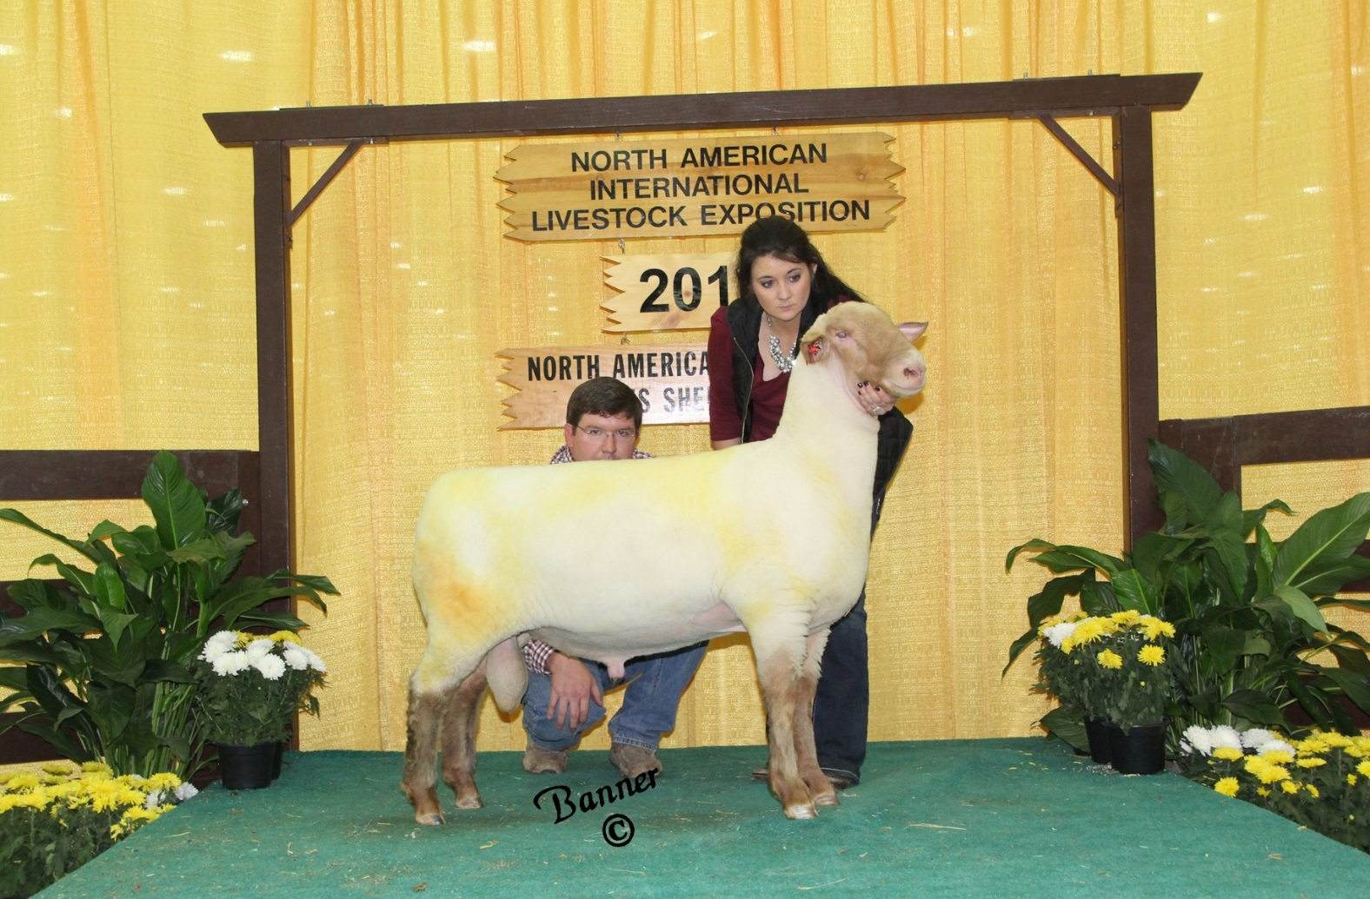
Tunis
Notes:
One of the oldest breeds of sheep indigenous to the US. Developed from importations of fat-tailed sheep from Africa and the Middle East
A flock of Tunis sheep was given to George Washington as a gift from the ruler of Tunisia. Thomas Jefferson was one of the chief importers of these sheep.
Nearly eliminated during the Civil War
Today they are noted for their efficiency, hardiness, and foraging ability.
Wool-free red face and legs and lambs are red when born

Slide 25
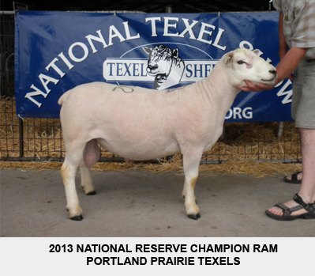
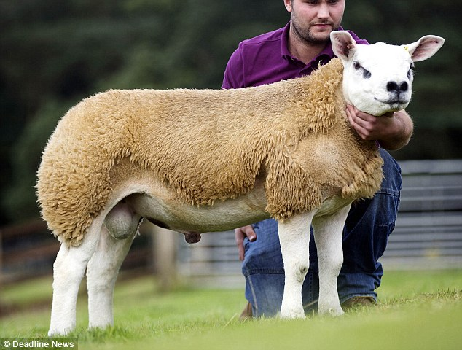
Texel
Notes:
Orginated on the Texel Isle off the coast of Netherlands. First imported to the meat animal research center at the University of NE in 1985.
White faced sheep with no wool on the legs or face. Shown slick shorn.
Expressive heavily muscled sheep. Strong Terminal Sire

Slide 26
Hair Sheep
More hair fibers and less wool
Easier to maintain
More heat-tolerant
More parasite resistant
Provide multiple lambing opportunities per year
Popular hair sheep breeds
Dorper
Katahdin

Slide 27
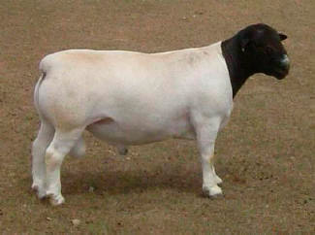
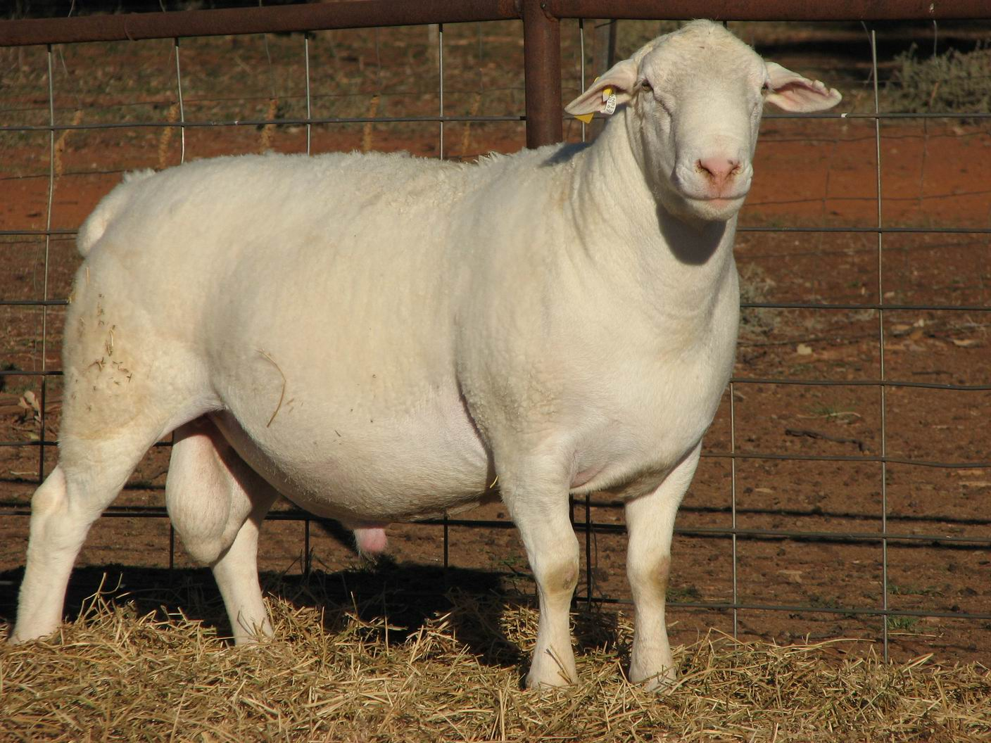
Dorper
Notes:
Developed in South Africa
Very hardy breed that is noted for its meat production
Small
Hair sheep
Low labor requirements

Slide 28
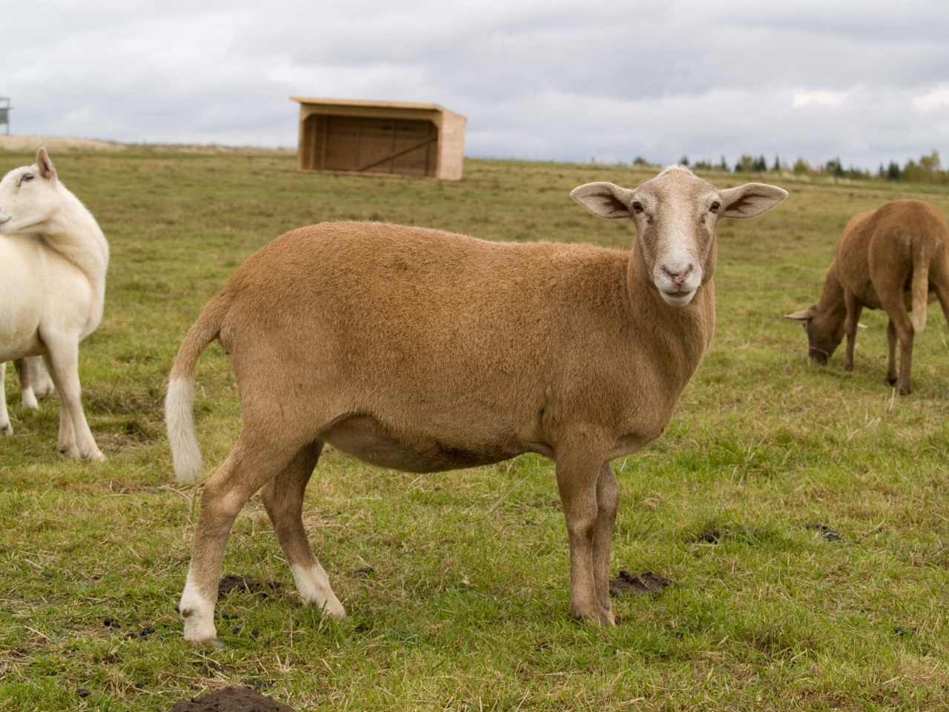
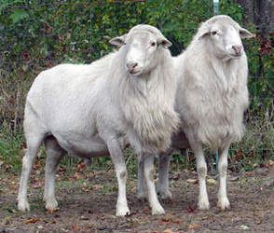
Katahdin
Notes:
Developed in Maine in the 1950’s
Developed as a low input sheep. A Meat sheep that did not require shearing
Brown, Black, or White in color
Small sheep with a tail

Slide 29
Natural Colored
Sheep with a dark fibered fleece

Slide 30
Natural Colored
Notes:
Not an actual breed. But instead a dark fleeced sheep of any breed.

